Slide 1





THE
POWER OF
WORDS

Slide 2
OBJECTIVES
• To understand how words have power
• To explore the different ways words can affect people
• To understand why what we say matters so much
• To put into practice what we’ve learned

Slide 3

WHAT DOES THE POWER OF WORDS MEAN?
“You’ll never manage that!”
“I believe in you!”

Slide 4




THE POSITIVE POWER OF WORDS
Connect
Support
Inspire
Empower

Slide 5




TRY TO AVOID WORDS THAT CAN...
Upset
Discourage
Exclude
Confuse

Slide 6


REAL WORLD EXAMPLES
“All you need is love...”
“I have a dream...”

Slide 7
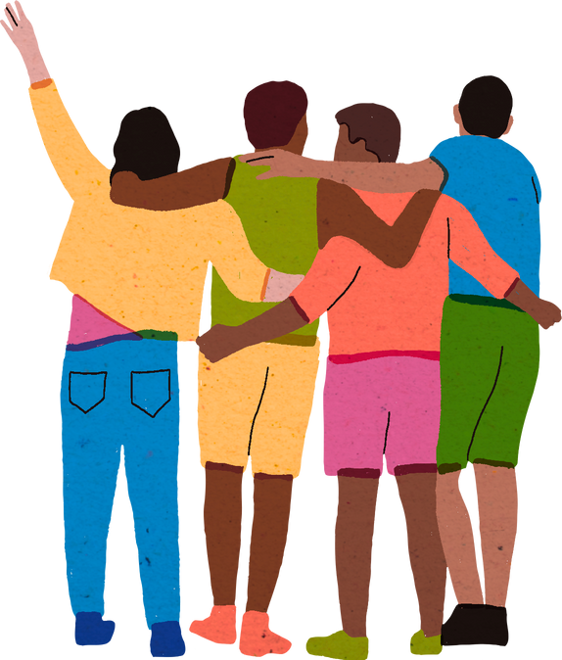
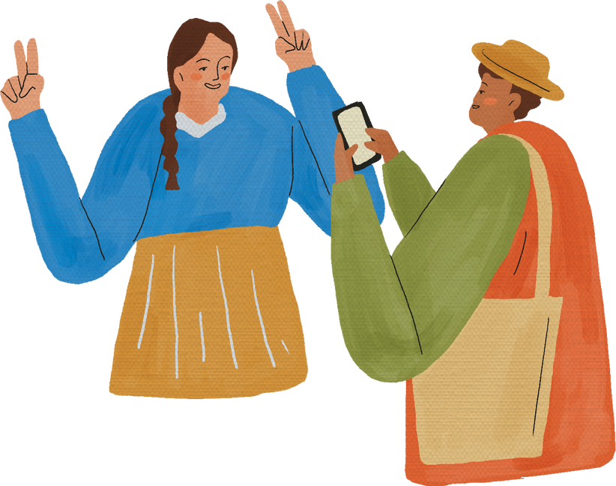
WHY DO WORDS MATTER?
Our word shape how others feel - online and offline

Slide 8
QUICK REFLECTION!
?
?
?

Slide 9

YOUR CHALLENGE!
What word will you choose?

Slide 10
ASKING FOR HELP
One of the most important things we can use our voices for is asking for help.
Talking about things that are concerning you, or asking for help with a problem can help you feel much better about things.
You may also find other people who share the same concern or problem!

Slide 11



WHO CAN WE TALK TO?
If you have anything you need to talk about, remember you can talk to…
• A friend
• A parent
• A teacher
• tootoot

Slide 12
WHAT IS TOOTOOT?
  You can use tootoot to talk about anything that is making you feel unhappy or unsafe, no matter how big or small.
  It is anonymous!
  Your message goes through to a trusted teacher who will help you.
  You can login to tootoot at yourschoolname.tootoot.co.uk or download the app!
  If you can’t remember your login please speak to teachersname who will help you reset it.

Slide 13
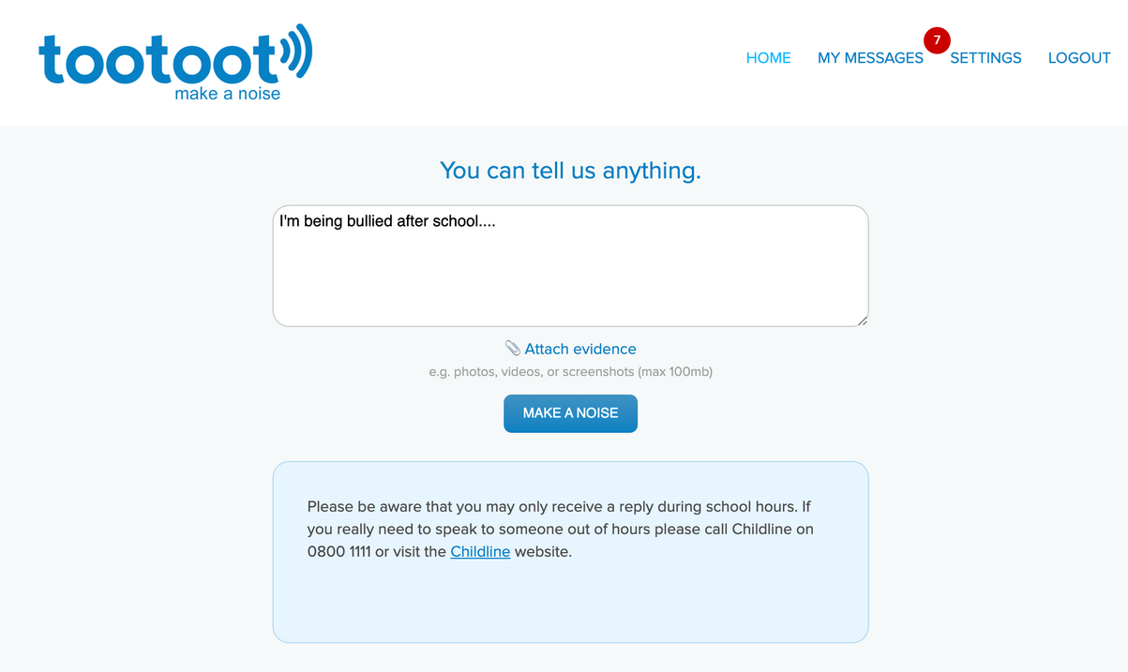
WHAT IS TOOTOOT?

Slide 14
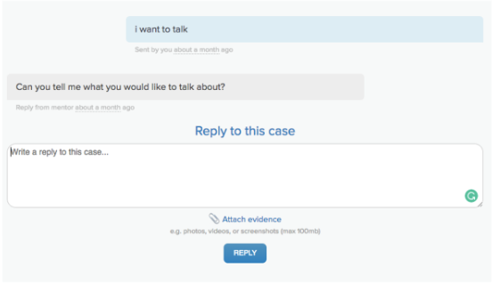
WHAT IS TOOTOOT?

Slide 15
THANK YOU!

