Slide 1





THE
POWER OF
WORDS

Slide 2
OBJECTIVES
• To understand how words have power
• To explore the different ways words can affect people
• To understand why what we say matters so much
• To put into practice what we’ve learned!

Slide 3

WHAT DOES THE POWER OF WORDS MEAN?
Words are incredibly powerful!
What you say and how you say it, can affect people’s mood and behaviour.
Is there a word that makes you feel good?

Slide 4


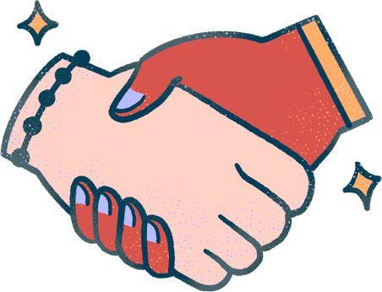

THE POSITIVE POWER OF WORDS
Connect
Support
Inspire
Empower

Slide 5

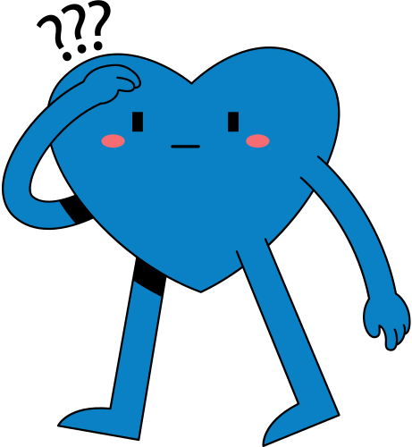

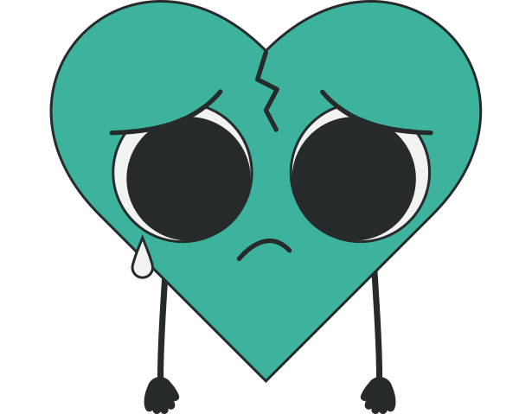
TRY TO AVOID WORDS THAT CAN...
Upset
Discourage
Exclude
Confuse

Slide 6
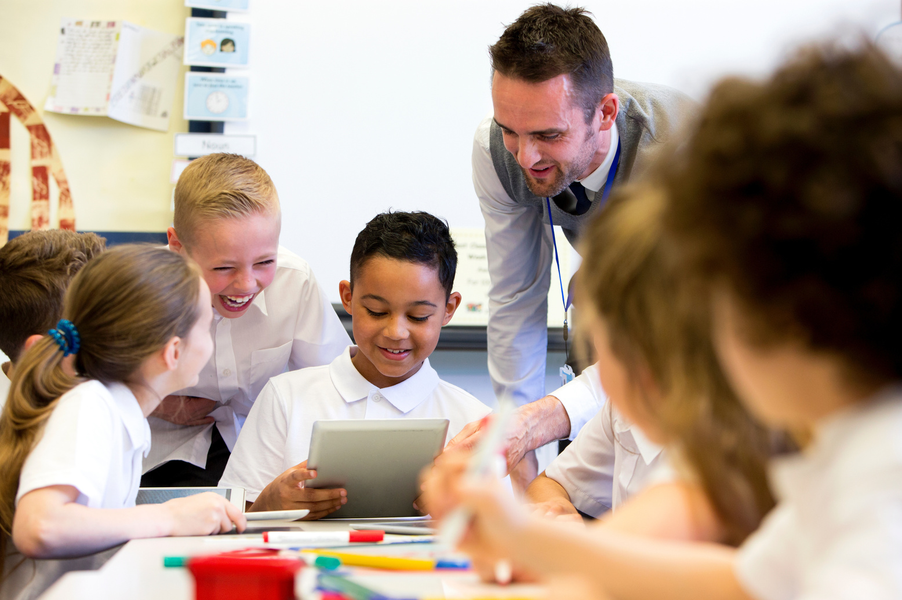
HOW DO YOU FEEL?

Slide 7
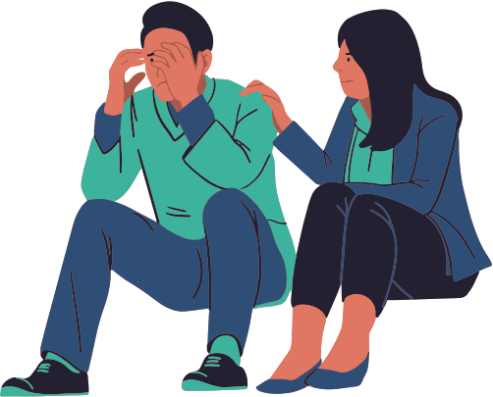
WHAT WE CAN SAY CAN CHANGE SOMEONE’S DAY!
Kind words can help friendships grow.
Unkind words can hurt feelings for a long time.
And it’s not just face-to-face - the same is true online.

Slide 8
WHY DO WORDS MATTER?
The right words can make the difference between
  Happiness and Sadness
  Confidence and Doubt
  Understanding and Confusion
  Success and Failure

Slide 9
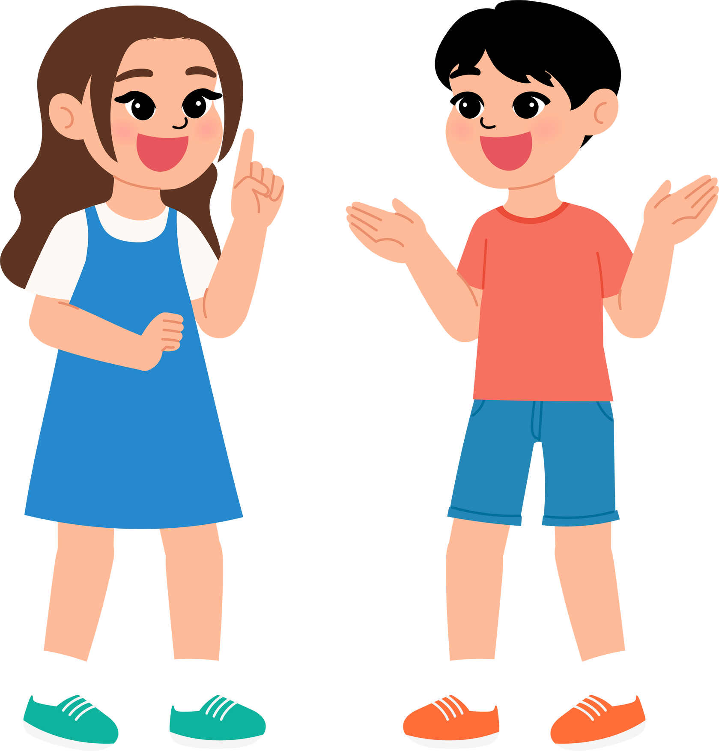
QUICK ACTIVITY!
Turn to the person next to you. Share one nice word or sentence with them.
How did it feel to hear something kind. And how did it feel to say something kind?

Slide 10
YOUR CHALLENGE
This week, we want you to take part in the Your Words Matter challenge.
You’ll get a speech bubble to write a word or short sentence that inspires, connects, supports, or empowers.
We’ll put them all together for a display, and some will be shared online.

Slide 11
ASKING FOR HELP
One of the most important things we can use our voices for is asking for help.
Talking about things that are concerning you, or asking for help with a problem can help you feel much better about things.
You may also find other people who share the same concern or problem!

Slide 12



WHO CAN WE TALK TO?
If you have anything you need to talk about, remember you can talk to…
• A friend
• A parent
• A teacher
• tootoot

Slide 13
WHAT IS TOOTOOT?
  You can use tootoot to talk about anything that is making you feel unhappy or unsafe, no matter how big or small.
  It is anonymous!
  Your message goes through to a trusted teacher who will help you.
  You can login to tootoot at yourschoolname.tootoot.co.uk or download the app!
  If you can’t remember your login please speak to teachersname who will help you reset it.

Slide 14
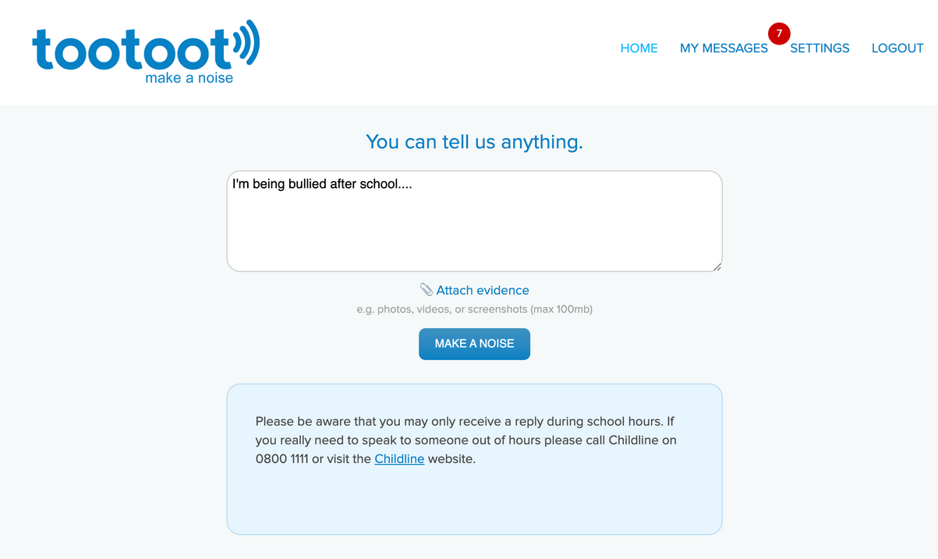
WHAT IS TOOTOOT?

Slide 15
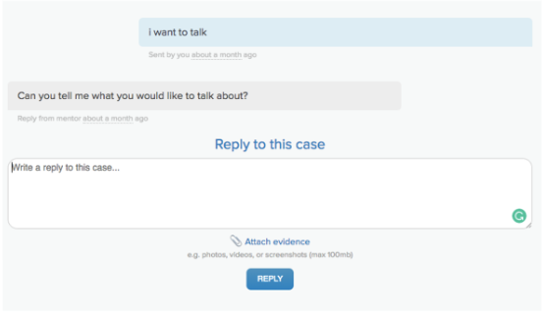
WHAT IS TOOTOOT?

Slide 16
THANK YOU!

