Slide 1
VotesforSchools Lesson Plan: 45 minutes Should we be worried about vaping?
1-2 mins | 1. Why are we talking about this? | Whole class | Voters explore why this topic is in the news at the moment, with reference to vaping.
10-16 mins | 2. Seeing through the mist | Pair/ Whole class | Voters discuss what vaping is in pairs. They are then introduced to addiction. The class complete facts and statistics about smoking and vaping with a show of fingers.
11-18 mins | 3. Know your audience | Whole class | Voters reflect on whether vaping products are marketed towards young people. They share and discuss their views on what gives them appeal. Then, they evaluate whether vaping products should be advertised.
6-10 mins | 4. Smoke and mirrors | Whole class | Voters consider predictions about the future of vaping. They give their view on the prediction’s accuracy with a hand gesture.
8-12 mins | 5. What’s the harm? | Pair/ Whole class | Voters discuss in pairs what reasons could be given for not vaping. Some “suggestions” are then offered. To extend, voters are encouraged to consider why simple advice to not do something is not always effective. To close, voters evaluate two statements about vaping.
N/A | Vote! | Whole class | Voters review the Yes/No arguments for this topic before casting their vote.
Keywords:
Vape
Nicotine
Addictive
Learning objectives:
To describe vaping.
To analyse the impact of vape use.
Supporting materials for SEND learners in this box
Cross curricular opportunities in this box
Challenge tasks in this box

Slide 3
Coming up this week…
Your learning objectives:
To describe vaping.
To analyse the impact of vape use.
Your key words:
Vape:
To breathe in nicotine or another drug as vapour rather than as smoke, especially using an e-cigarette.
Nicotine:
A poisonous chemical, found in tobacco, that is addictive.
Notes:
References
https://dictionary.cambridge.org/dictionary/english/vape
https://dictionary.cambridge.org/dictionary/english/nicotine

Slide 4
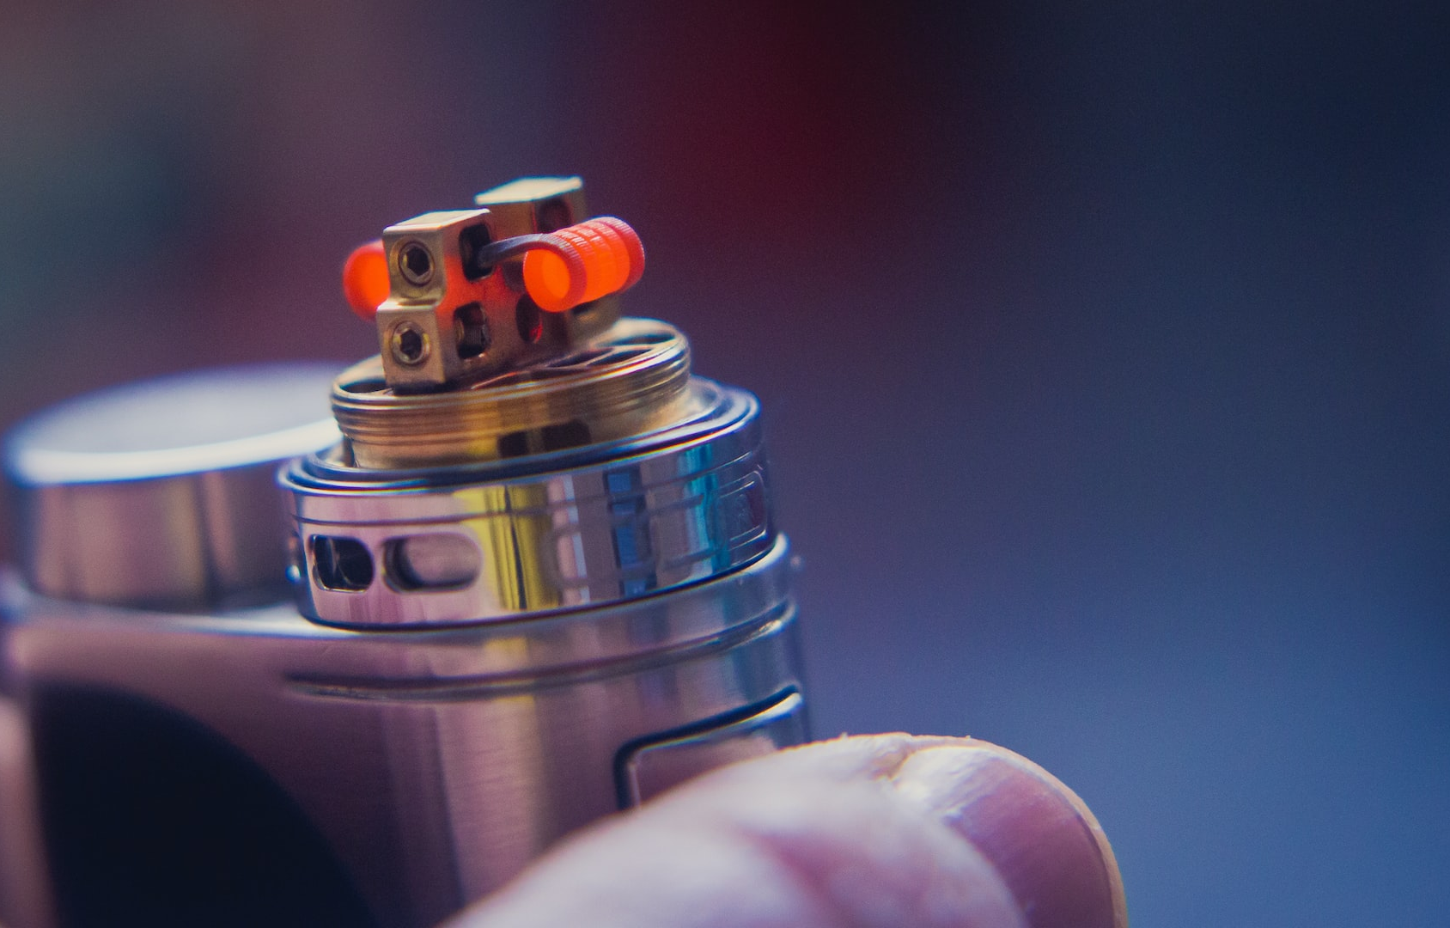
This week’s VoteTopic
Should we be worried about vaping?
©VotesforSchools2023
Notes:
Images
Unsplash (https://unsplash.com/photos/9vs_XsYwsdE)

Slide 5
1
Why are we talking about this?
We’ve all seen and smelled the smoke from vaping. Increasingly, this is being seen in school environments too.
Vape:
To breathe in nicotine or another drug as vapour rather than as smoke, especially using an e-cigarette.
Vaping is seen as an answer to the awful health damage caused by cigarettes. Like cigarettes before them, are vapes something to worry about?
Notes:
Images
Unsplash
References
https://en.wikipedia.org/wiki/BBC

Slide 6
2
Seeing through the mist
Pair discussion (2-3 mins)
Let’s get on the same page with vaping. Can you explain the role of the labelled parts of a vape below? Discuss your thoughts with your partner.
Vapour containing nicotine is released here.
Mouth piece
The battery and heating element vaporise the vaping liquid.
Heating element
Liquid, or “juice”, with nicotine added
This liquid is often given flavourings. The added nicotine is a drug.
Battery
Across the curriculum – Physics:
What energy transfers happen in a vaping device?
Notes:
Images
Pixabay
References
https://en.wikipedia.org/wiki/Construction_of_electronic_cigarettes

Slide 7
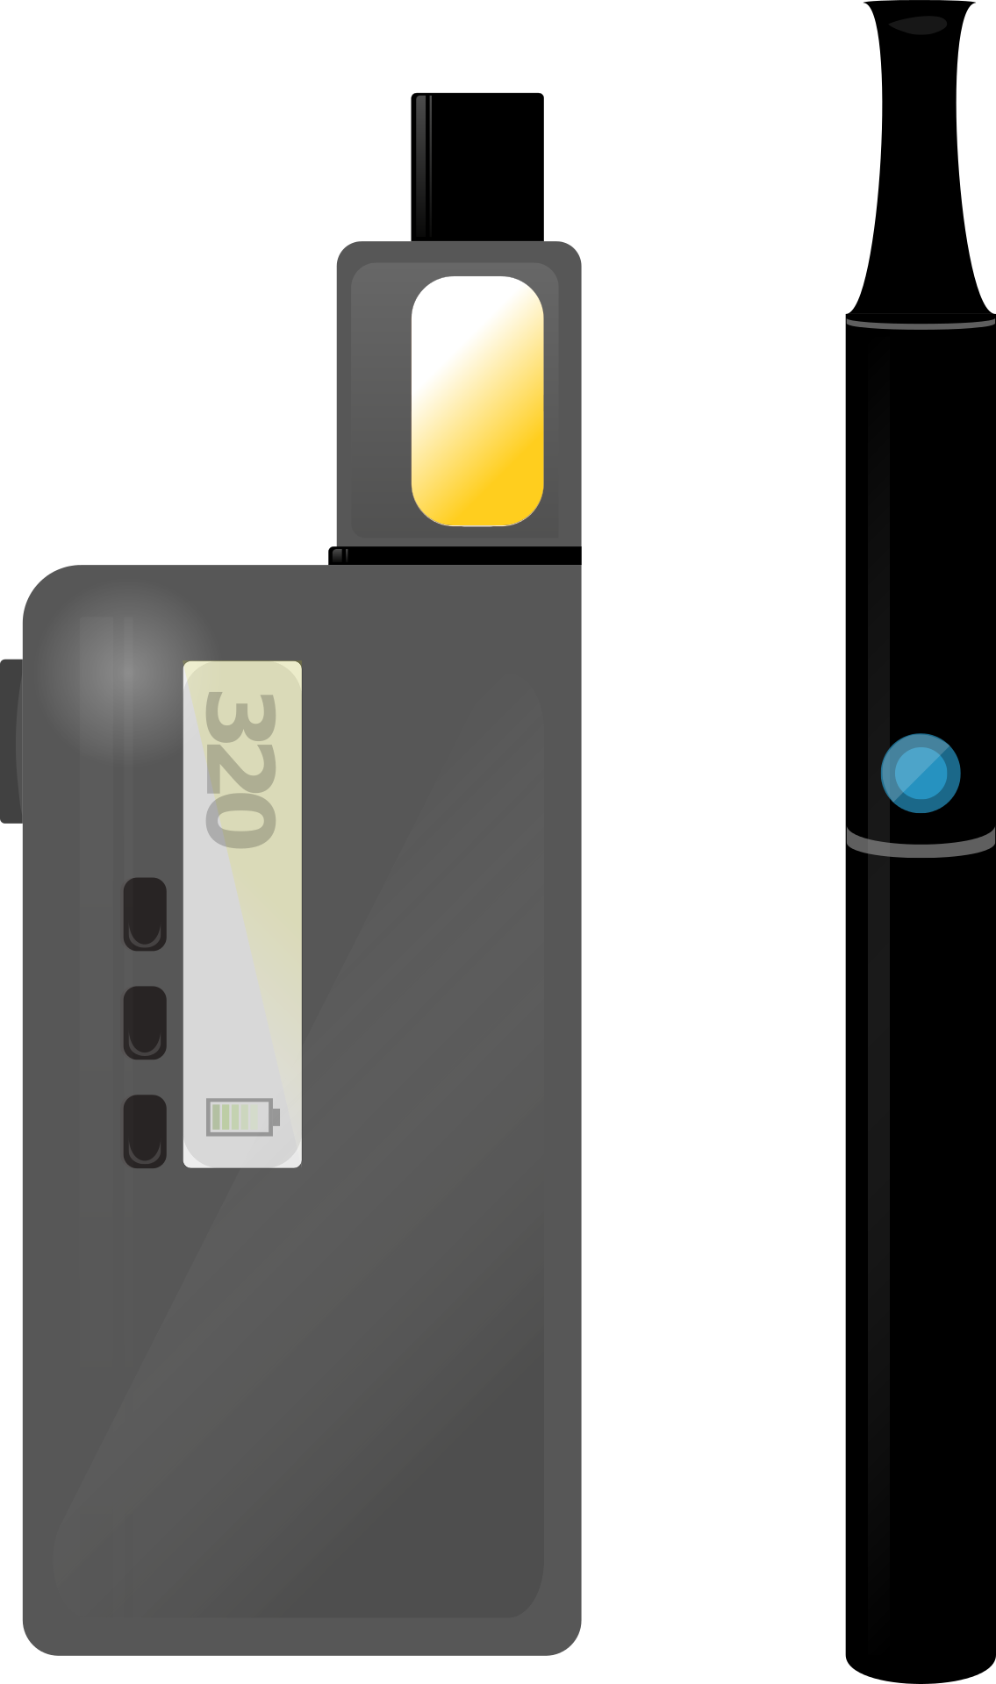
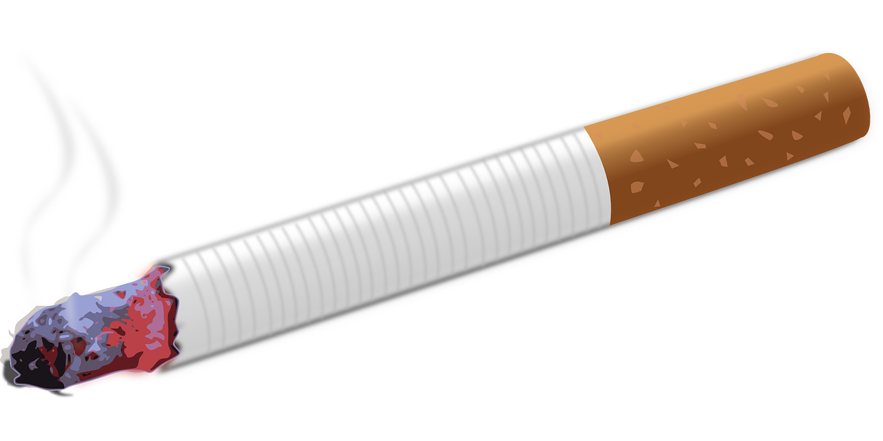
2
Seeing through the mist
The addition of the drug nicotine to vaping liquid has consequences.
Nicotine occurs naturally in tobacco. Its presence is a reason for smoking being an addictive habit, despite all the health problems it causes.
Addictive:
Something that you cannot easily stop taking once you have started.
The nicotine in vaping fluid gives smokers a less dangerous alternative to tobacco whilst continuing to fulfil their addiction.
For non-smokers, the nicotine in vaping fluid can create a new addiction.
Notes:
Images
Pixabay
References
https://www.fda.gov/tobacco-products/health-effects-tobacco-use/nicotine-why-tobacco-products-are-addictive
https://dictionary.cambridge.org/dictionary/english/addictive

Slide 8
2
Seeing through the mist
Smoking and vaping are connected. Some people have given up smoking to vape.
Class activity (5-10 mins)
Let’s explore smoking and vaping with a quiz. Complete the facts and statistics with a show of your fingers.
Notes:
Images
Unsplash
Pixabay
References
https://

Slide 9
2
Seeing through the mist
6% of 11- to 15-year olds vaped in 2018. In 2022, this percentage was _ _ _ _ .
15%
4%
9%
Notes:
Images
Unsplash
Pixabay
References
https://digital.nhs.uk/news/2022/decrease-in-smoking-and-drug-use-among-school-children-but-increase-in-vaping-new-report-shows#:~:text=The%20number%20of%20young%20people,1%2C%20statistics%20published%20today%20show

Slide 10
2
Seeing through the mist
In 2022 just 3% of 11- to 15-year olds smoked. This is down from _ _ _ _ in 2018.
5%
10%
7.5%
Notes:
Images
iStock
Pixabay
References
https://digital.nhs.uk/news/2022/decrease-in-smoking-and-drug-use-among-school-children-but-increase-in-vaping-new-report-shows#:~:text=The%20number%20of%20young%20people,1%2C%20statistics%20published%20today%20show

Slide 11
2
Seeing through the mist
It’s estimated that each cigarette smoked reduces your life span on average by _ _ _ _ .
55 minutes
11 minutes
5 minutes
Notes:
Images
Unsplash
Pixabay
References
https://www.ncbi.nlm.nih.gov/pmc/articles/PMC1117323/

Slide 12
2
Seeing through the mist
Since May 2016, there have been _ _ _ _ _ deaths in the UK linked with vaping products.
twenty seven
three
zero
Notes:
Images
Unsplash
Pixabay
References
https://www.theguardian.com/society/2022/aug/07/when-i-see-kids-vaping-i-warn-them-thats-what-killed-my-daughter

Slide 13
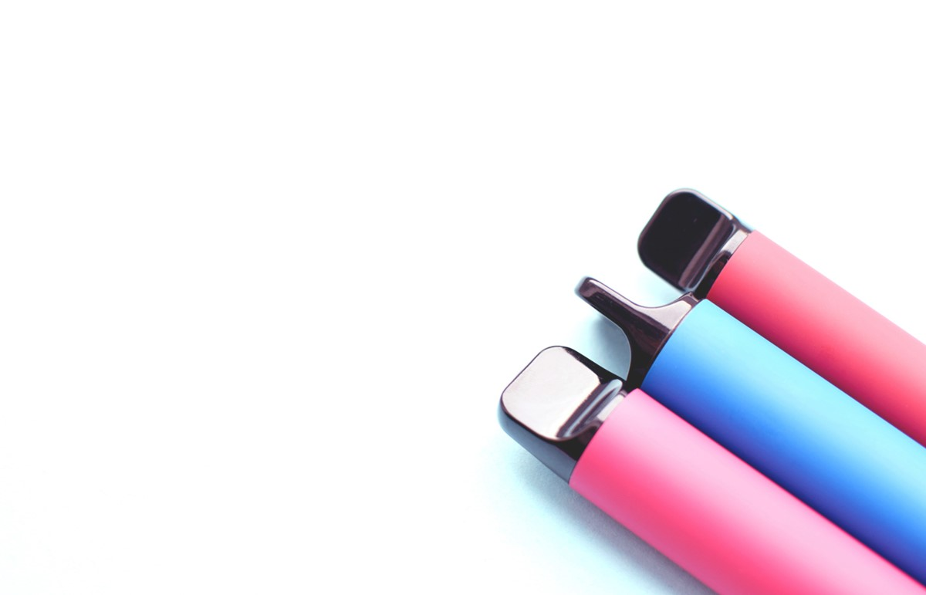
2
Seeing through the mist
Disposable vape pens contain plastics, copper and lithium. _ _ _ _ _ _ _ are sold weekly in the UK. That’s a lot of waste!
2,000,000
500,000
1,000,000
©VotesforSchools2023
Notes:
Images
iStock
Pixabay
References
https://www.bbc.co.uk/news/science-environment-63037553

Slide 14
3
Know your audience
The number of Secondary school students vaping has been rising. 9% of 11-15-year olds say they vape.
Concerns have been raised that bright and colourful packaging and a wide selection of flavours are ideal ways to advertise vaping products to young people.
©VotesforSchools2023
Notes:
Images
Unsplash
References
https://www.bbc.co.uk/news/health-62807001
https://metro.co.uk/2022/07/06/health-ads-on-tiktok-and-instagram-behind-rise-in-children-vaping-16956414/
https://news.sky.com/story/crackdown-needed-to-stop-children-buying-vapes-experts-warn-12707632

Slide 15
3
Know your audience
Fitting in
(peer pressure)
Adverts
Addictive nicotine
Use by influencers on socials
“Not as dangerous as smoking”
Friends and family
Fruity flavours
Colourful packaging
Class discussion (5-10 mins)
Which features of vaping products appeal to young audiences? Discuss the possible features here, along with your own ideas.
Easy access
(£5 for a disposable “puff bar”)
©VotesforSchools2023
Notes:
Images
iStock
References
https://news.sky.com/story/crackdown-needed-to-stop-children-buying-vapes-experts-warn-12707632

Slide 16
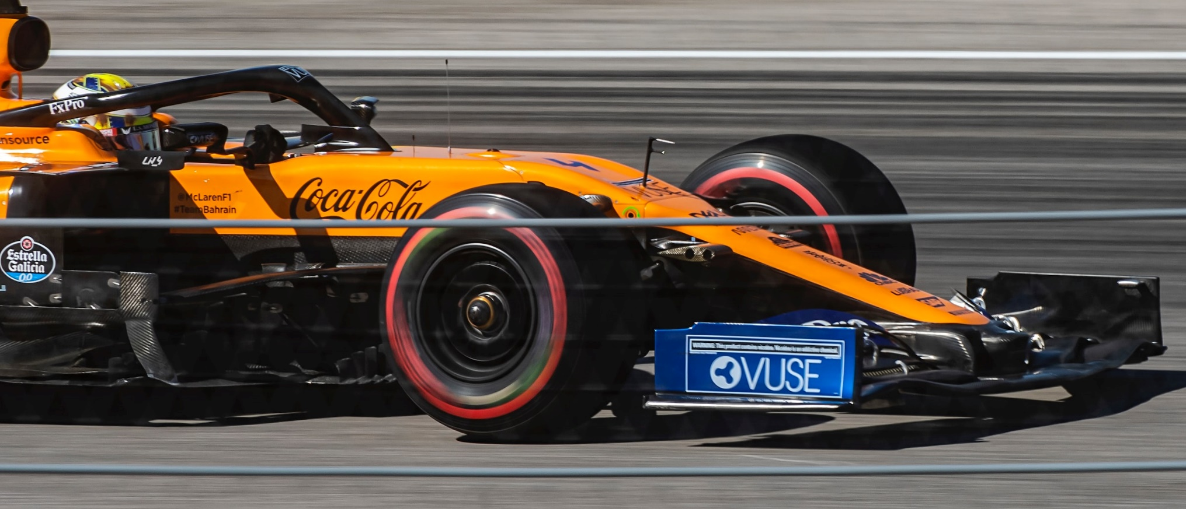
3
Know your audience
Tobacco products have not been advertised on Formula 1 cars since 2006. However, vaping products have been sponsors in recent years.
Class discussion (4-6 mins)
Should companies be allowed to advertise vaping products?
©VotesforSchools2023
Notes:
Images
Unsplash
References
https://www.electrictobacconist.co.uk/blog/is-formula-one-out-of-gear-with-vaping-ads
https://www.mclaren.com/racing/2021/abu-dhabi-grand-prix/mclaren-racing-and-vuse-reveal-one-livery-designed-emerging-uae-based-artist-abu-dhabi-gp/
https://www.theguardian.com/sport/2019/mar/15/f1-has-no-plans-to-ban-tobacco-company-sponsorship-despite-health-calls-australian-gp-lewis-hamilton-sebastian-vettel

Slide 17
4
Smoke and mirrors
The use of tobacco products has fallen and vaping is now more common. What other changes could there be in the use of addictive nicotine products in the future?
Class activity (6-10 mins)
Read the following predictions. If you think the prediction is possible, put your hands to your eyes. If you do not see the prediction happening, cross your arms.
I can see this happening!
This isn’t going to happen!
Notes:
Images
iStock
Pixabay
Unsplash
References
https://

Slide 18
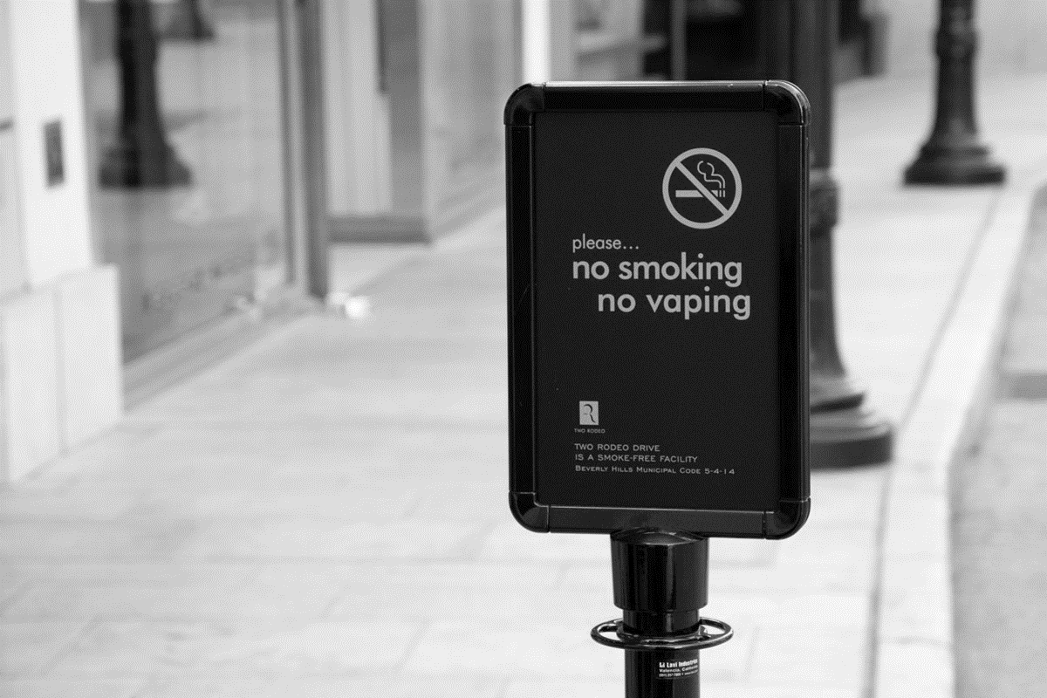
4
Smoke and mirrors
Vaping will be banned in all public spaces.
©VotesforSchools2023
Notes:
Images
Unsplash
Pixabay
References
https://

Slide 19
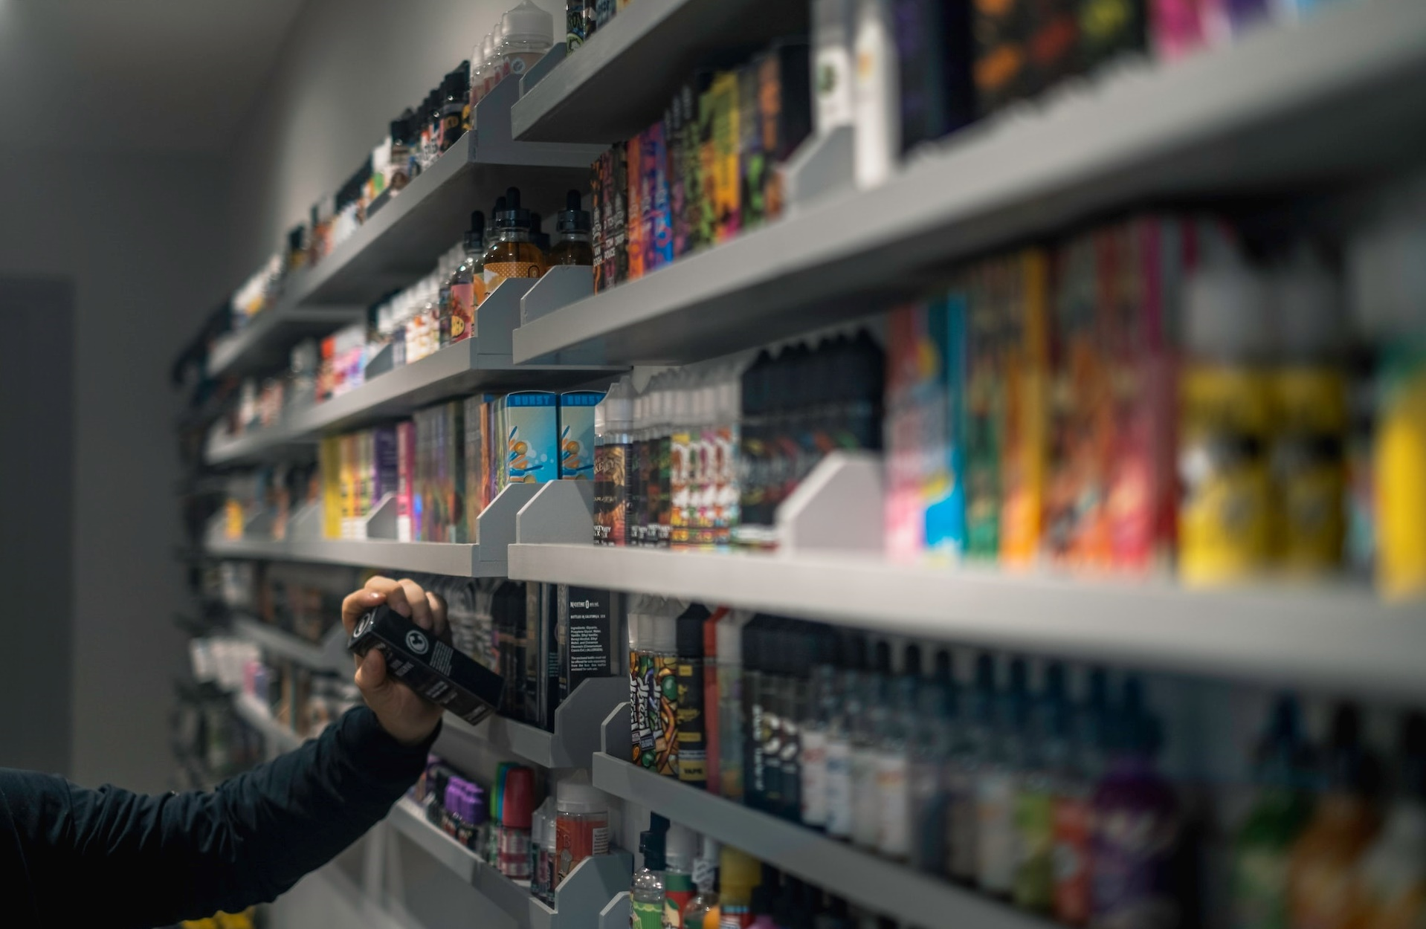
4
Smoke and mirrors
Vapes will have explicit health warnings and no branding.
©VotesforSchools2023
Notes:
Images
Unsplash
Pixabay
References
https://

Slide 20
4
Smoke and mirrors
People will feed their nicotine addiction with a daily pill rather than smoking or vaping.
©VotesforSchools2023
Notes:
Images
Unsplash
Pixabay
References
https://

Slide 21
4
Smoke and mirrors
Vaping will become so common it’ll be uncool to be seen doing it.
©VotesforSchools2023
Notes:
Images
Unsplash
Pixabay
References
https://

Slide 22
4
Smoke and mirrors
The NHS will campaign against vaping.
©VotesforSchools2023
Notes:
Images
Unsplash
Pixabay
References
https://

Slide 23
4
Smoke and mirrors
People will take up vaping products without any nicotine in them. After all, it’s all about the flavour and smoke, right?
©VotesforSchools2023
Notes:
Images
Unsplash
Pixabay
References
https://

Slide 24
5
What’s the harm?
Pair discussion (3-5 mins)
This won’t be the first time you’ve heard a list of reasons to not do drugs or something else dangerous. What problems do you think we could list about vaping?
Notes:
Images
Unsplash
References
https://

Slide 25
5
What’s the harm?
The long-term health effects are unknown! Back in my day we thought cigarettes wouldn’t hurt us either!
Please stop…
You smell like cheap bubblegum!
Instead of vaping that money away, you could buy a Ferrari in a few years!
It starts with vaping, it’ll lead to… illegal things!
Challenge:
Is it useful to simply advise someone “not to vape”?
You think it’s cool now!
Notes:
Images
iStock
References
https://

Slide 26
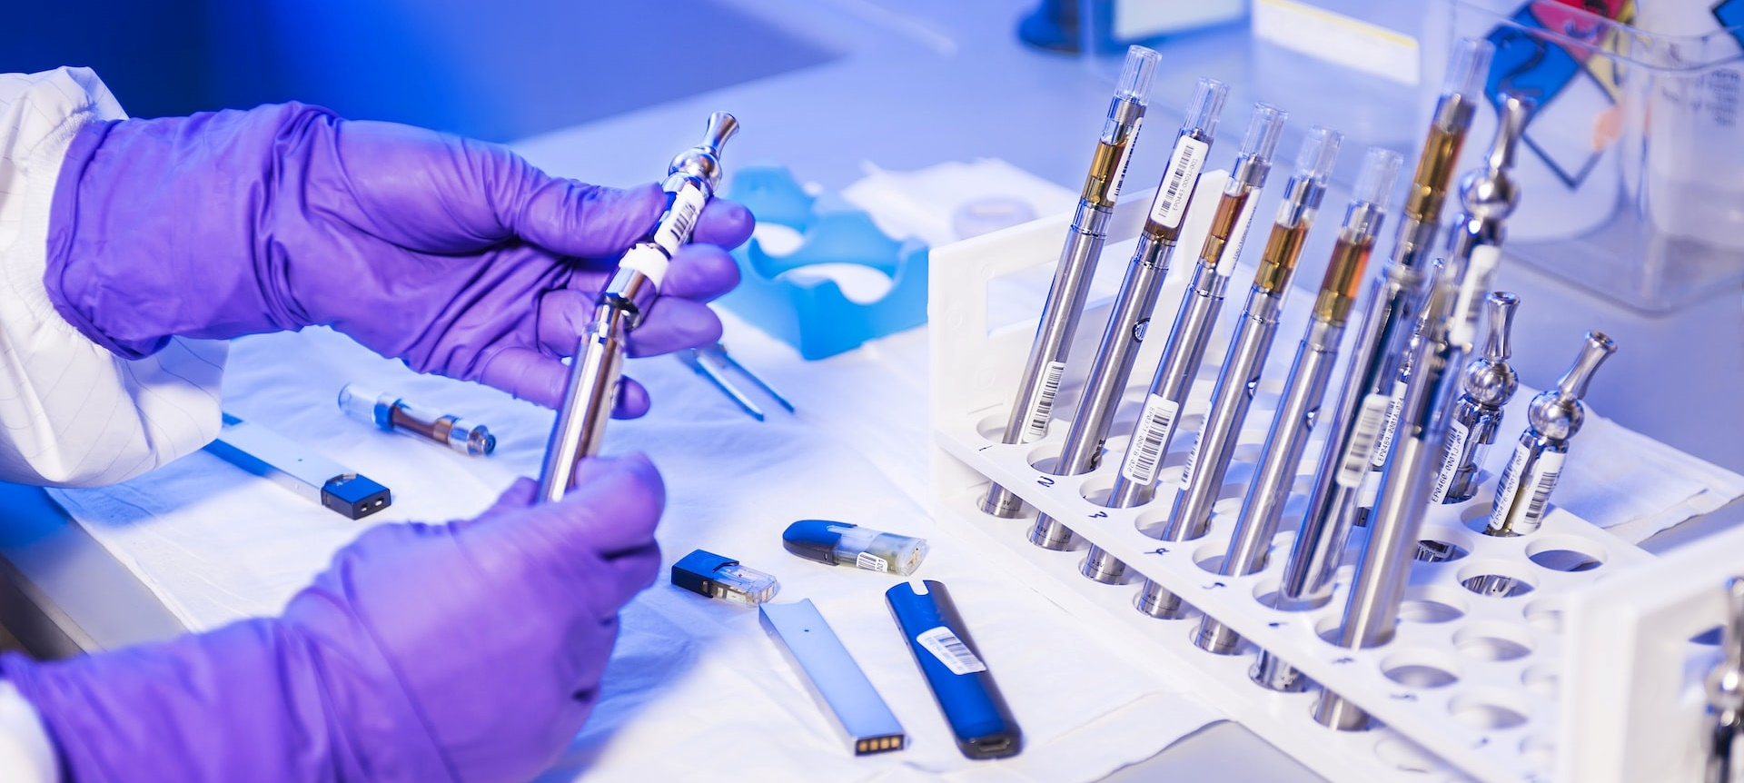
5
What’s the harm?
There is work happening to study and understand the safety of vaping. It will take time to know the long-term effects.
Class discussion (3-5 mins)
Which of the statements below do you agree with?
Sounds like history repeating itself. No one should take risks with their health when we don’t know what future problems vaping may cause.
We know the horrific health problems of smoking. It is clear that vaping should be recommended to help smokers quit.
Notes:
Images
Unsplash
References
https://

Slide 27
Vote!
We don’t know what the future harm could be. They used to say smoking was healthy!
Where does vaping lead? Into smoking or something more? Or will that one addiction be enough?
There’s better things to spend money on than stuff that goes up in smoke.
Should we be worried about vaping?
It’s good that some people have taken up vaping and stopped smoking.
It doesn’t seem the health effects are as bad as smoking. That’s a plus.
It’s another fashionable trend that will go away soon enough.
Head to the next slide to find out what children & young people had to say about this topic and who we shared the results with!
©VotesforSchools2023
Notes:
Images
Unsplash (https://unsplash.com/photos/9vs_XsYwsdE)

Slide 28
How do your results compare?
42,907 children & young people got involved in the national conversation!
“The lack of knowledge we have on vapes is reason enough to be wary.”
Secondary school, Dorset
“Why should we be worried about somebody else messing up their lives?”
Secondary school, Greater Manchester
Yes
No
73.0%
27.0%
We went on to share voters’ comments with…
©VotesforSchools2023
Notes:
Images
https://en.wikipedia.org/wiki/Childline
https://en.wikipedia.org/wiki/Public_Health_England
https://ash.org.uk/
https://www.healthyschools.org.uk/
https://en.wikipedia.org/wiki/Mumsnet

Slide 29
Want to get involved?
Did you enjoy this lesson?
VotesforSchools creates award-winning weekly resources that meet PSHE, SMSC, British Values & Prevent curriculum aims.
To see how this lesson met the different curriculum aims, download our curriculum maps:
English & Welsh Curriculum Map
Scottish Curriculum Map
Want to take part in weekly debates?
To find out what the whole VotesforSchools package includes, and how it can help your school:
Book a demo
Contact us
©VotesforSchools2023
Notes:
Images
https://icons8.com

