Slide 2
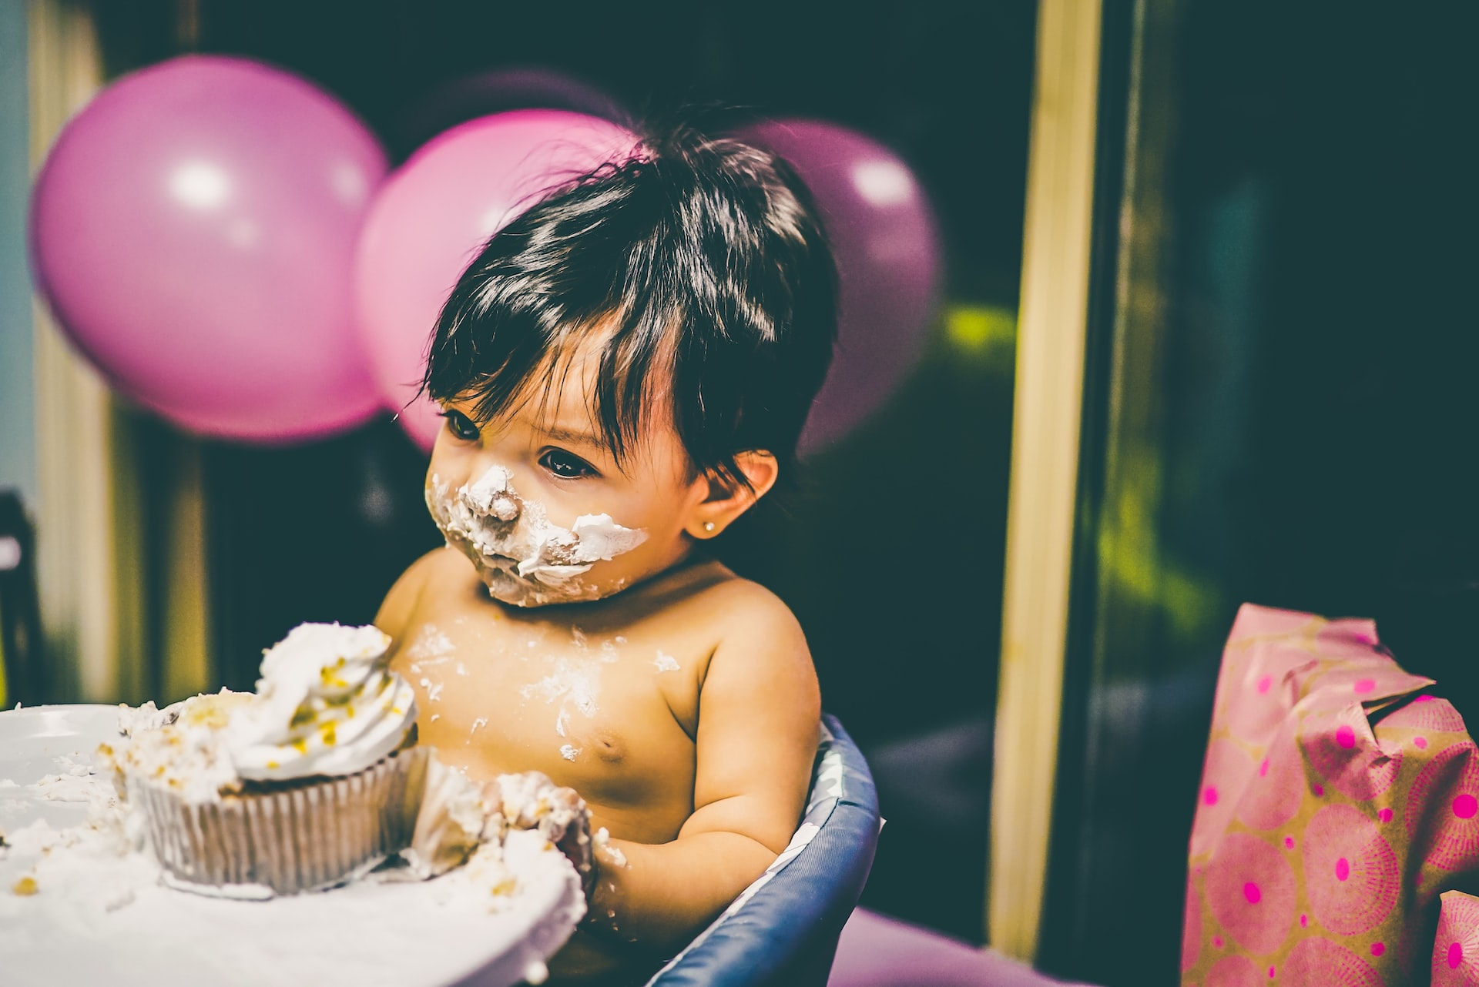
Thought of the week…
Can we have too much of a good thing?
©VotesforSchools2023
Notes:
Images
Unsplash

Slide 3
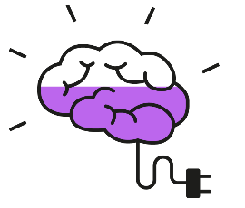
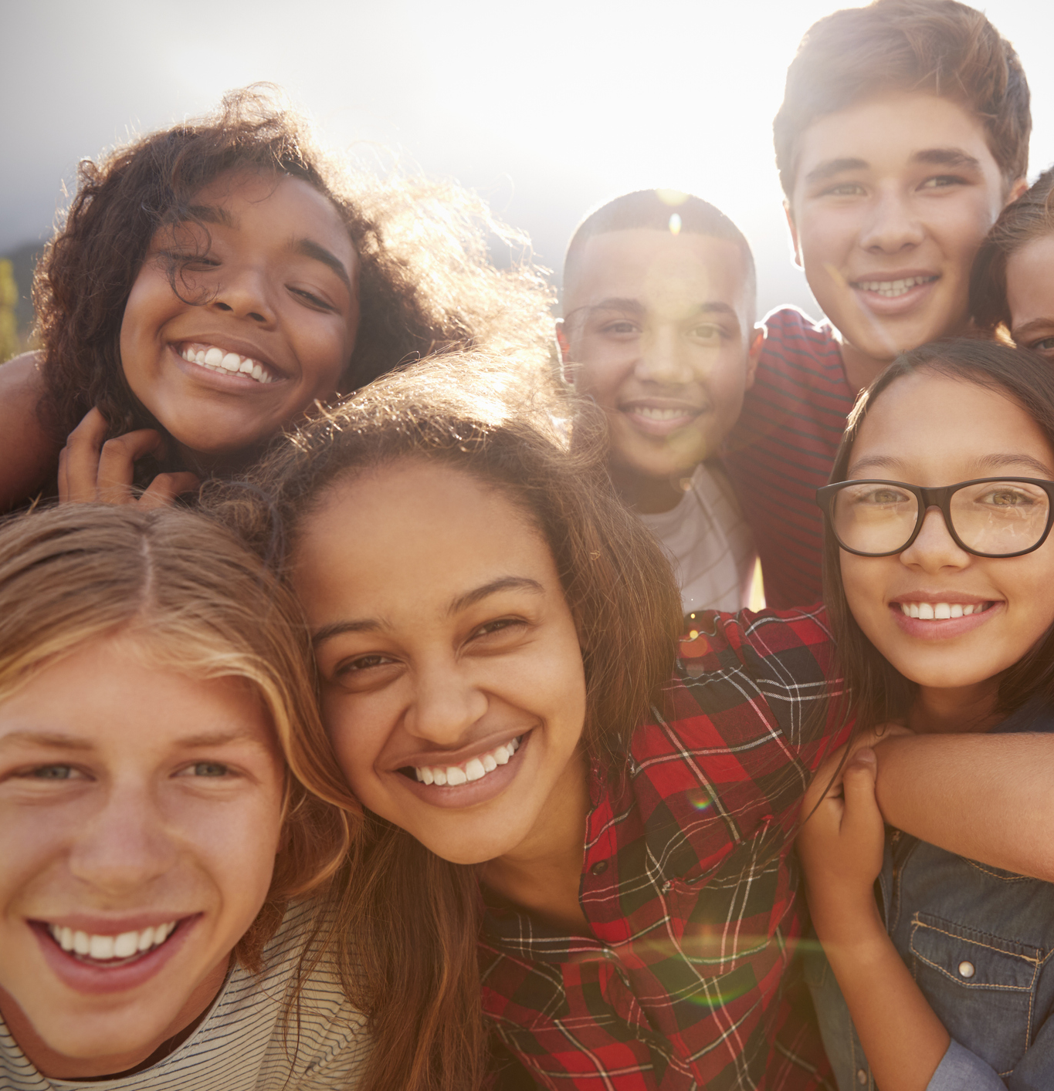
Be informed: And I’m feeling good
Feeling good is a pretty important part of life.
Like our feelings, the human body can be pretty complicated! What happens to us can make our bodies produce chemicals that can affect how we feel.
That means actions we take can make us feel good. How we are treated can also change our mood.
Notes:
Images
iStock
References
https://

Slide 4
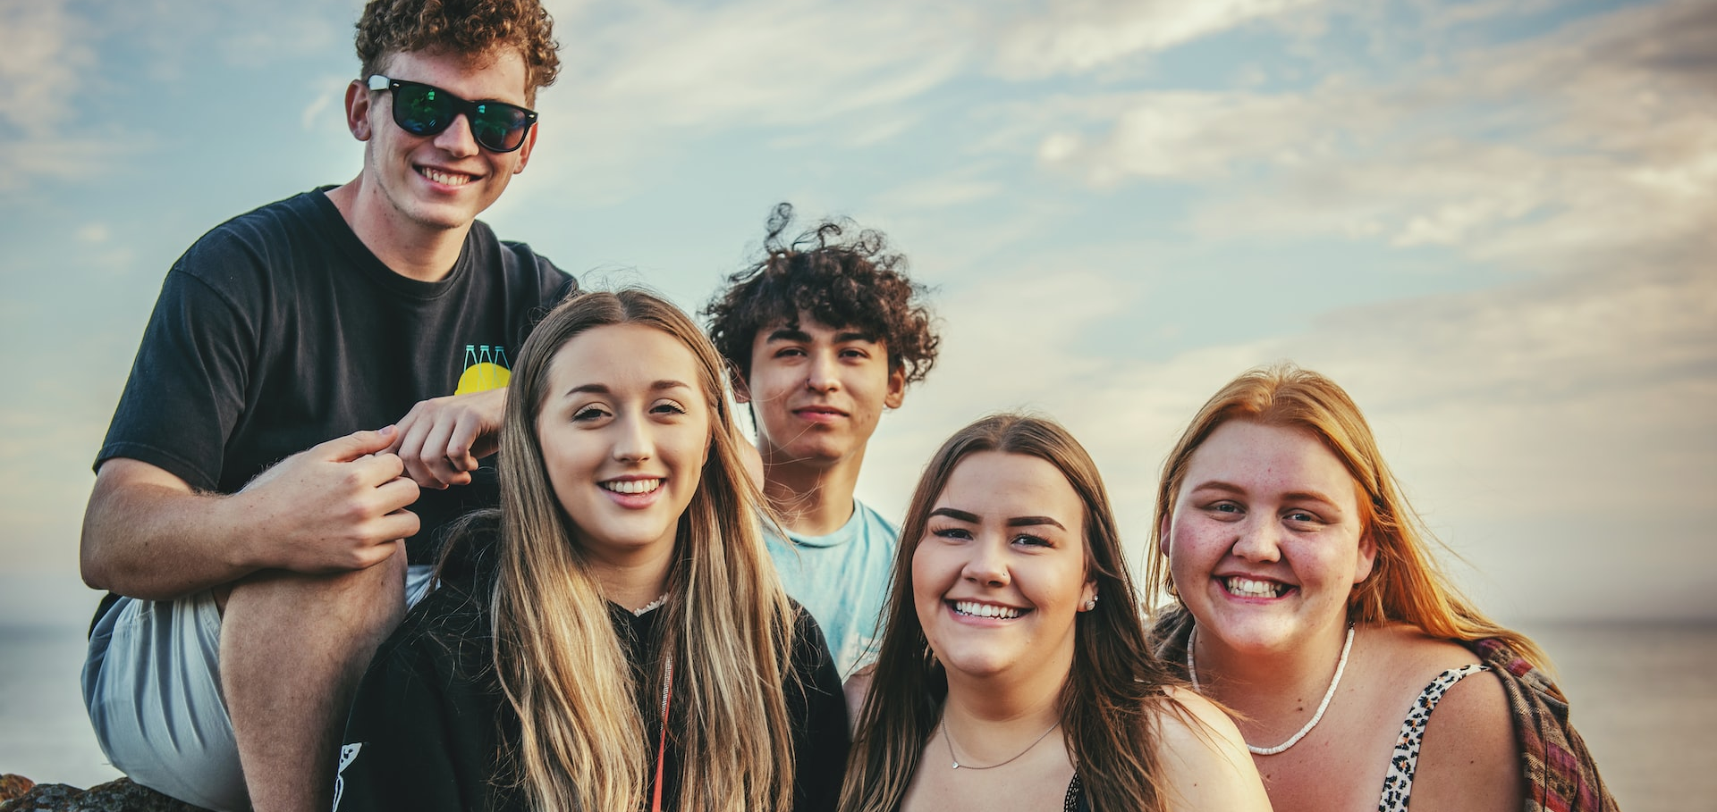
Be informed: And I’m feeling good
Did you know?
Dopamine and serotonin are chemicals that we produce that can make us feel happy.
What actions change our moods in our everyday lives? Can our desire to feel good affect us in ways we don’t expect? Let’s take a look…
Notes:
Images
Unsplash
References
https://www.henryford.com/blog/2021/05/how-to-boost-feel-good-hormones-naturally#:~:text=Dopamine%3A%20Often%20called%20the%20%22happy,ll%20get%20a%20dopamine%20hit.
https://www.healthline.com/health/happy-hormone

Slide 5
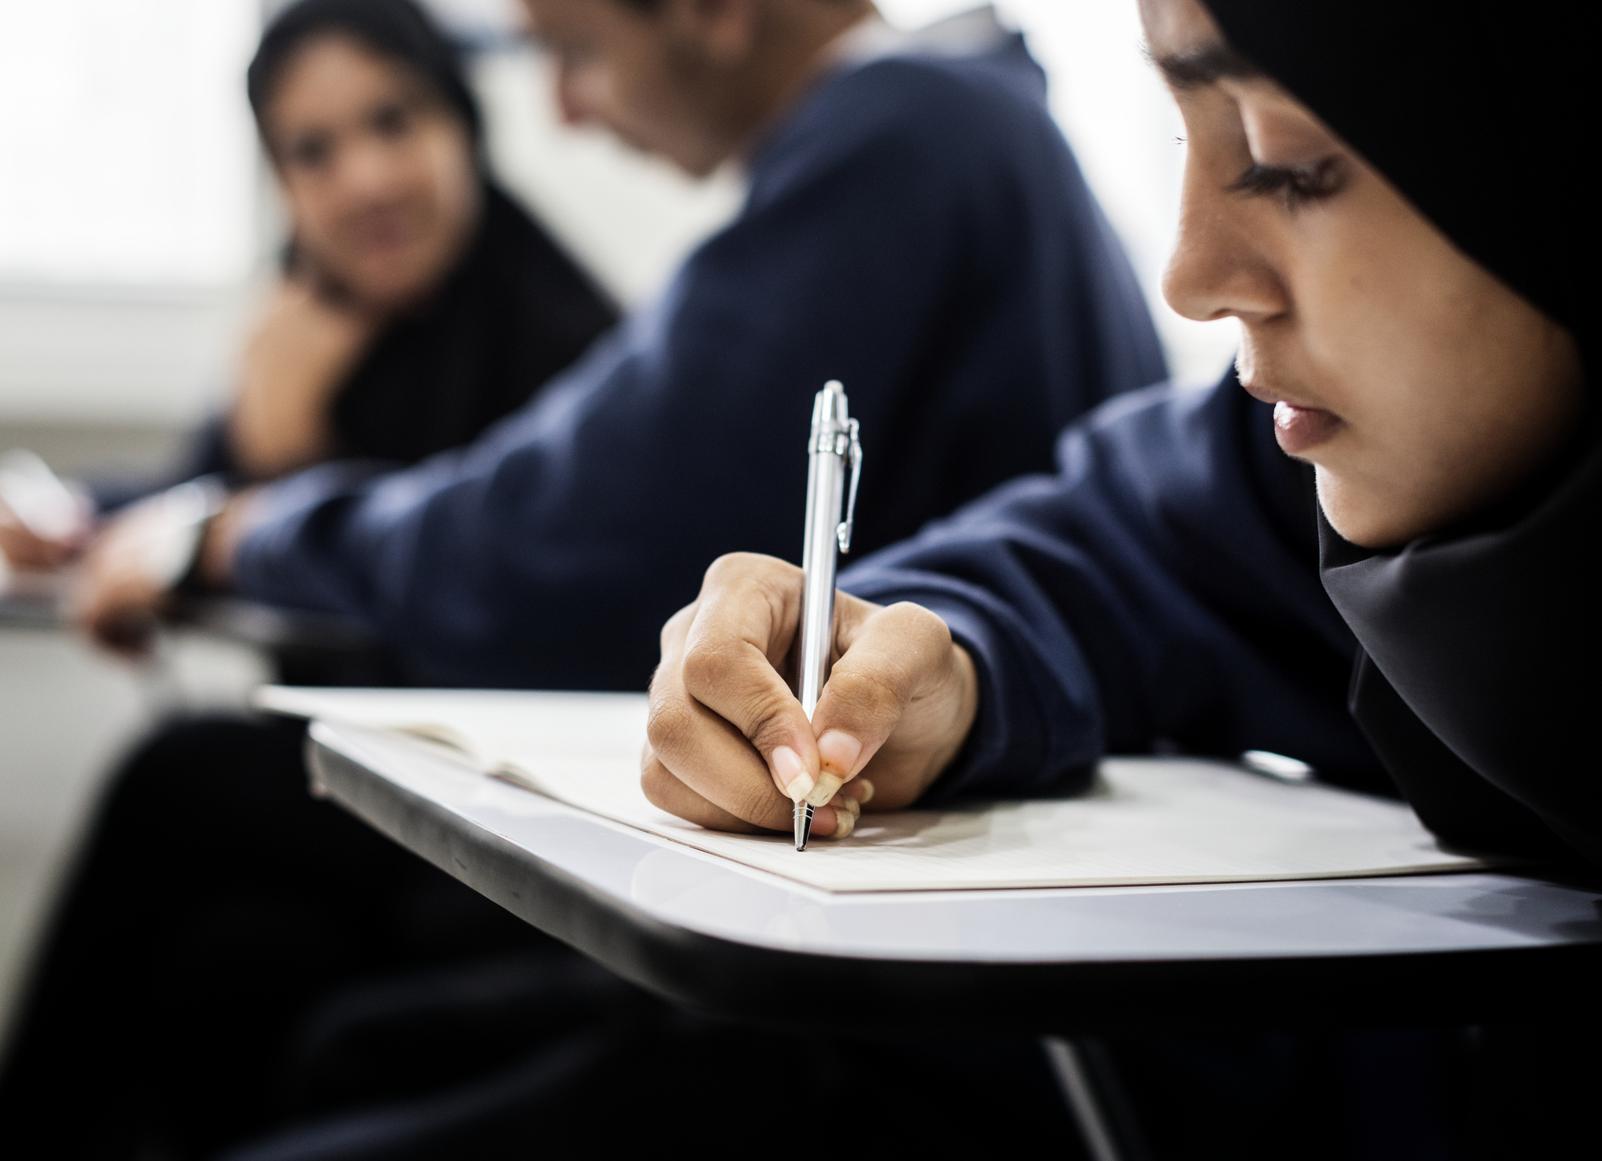
Be curious: All the small things
Time to reflect…
Let’s take a look at some everyday events. Do they make you feel good? Give a thumbs up if they do. Give a thumbs down if they don’t.
Notes:
Images
Unsplash
Microsoft Fluent Emoji – Via Emojipedia

Slide 6
Be curious: All the small things
Receiving good feedback when your book is marked.
©VotesforSchools2023
Notes:
Images
iStock
Microsoft Fluent Emoji – Via Emojipedia

Slide 7
Be curious: All the small things
Doing something new and difficult in a video game.
©VotesforSchools2023
Notes:
Images
Unsplash
Microsoft Fluent Emoji – Via Emojipedia

Slide 8
Be curious: All the small things
Spending time with friends and family.
©VotesforSchools2023
Notes:
Images
Unsplash
Microsoft Fluent Emoji – Via Emojipedia

Slide 9
Be curious: All the small things
Receiving likes on your latest post.
©VotesforSchools2023
Notes:
Images
Unsplash
Microsoft Fluent Emoji – Via Emojipedia

Slide 10
Be curious: All the small things
Eating something you enjoy.
©VotesforSchools2023
Notes:
Images
Unsplash
Microsoft Fluent Emoji – Via Emojipedia

Slide 11
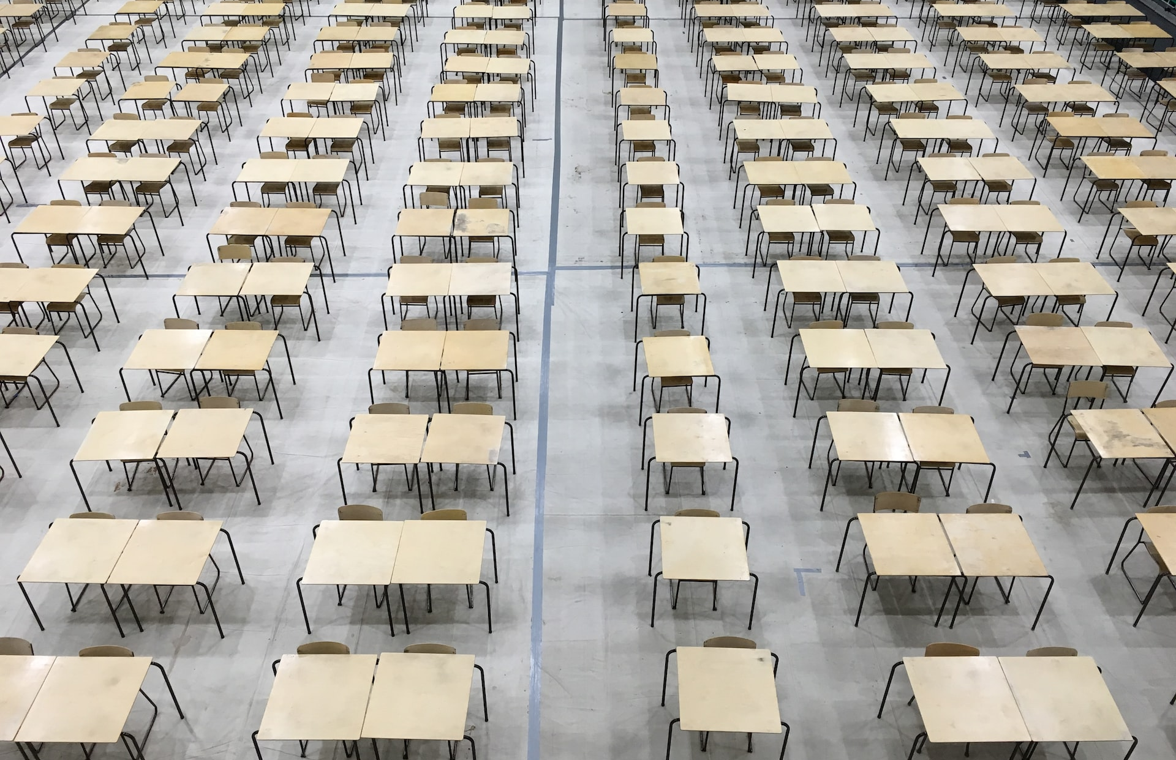
Be curious: All the small things
Walking out of an exam.
©VotesforSchools2023
Notes:
Images
Unsplash
Microsoft Fluent Emoji – Via Emojipedia

Slide 12
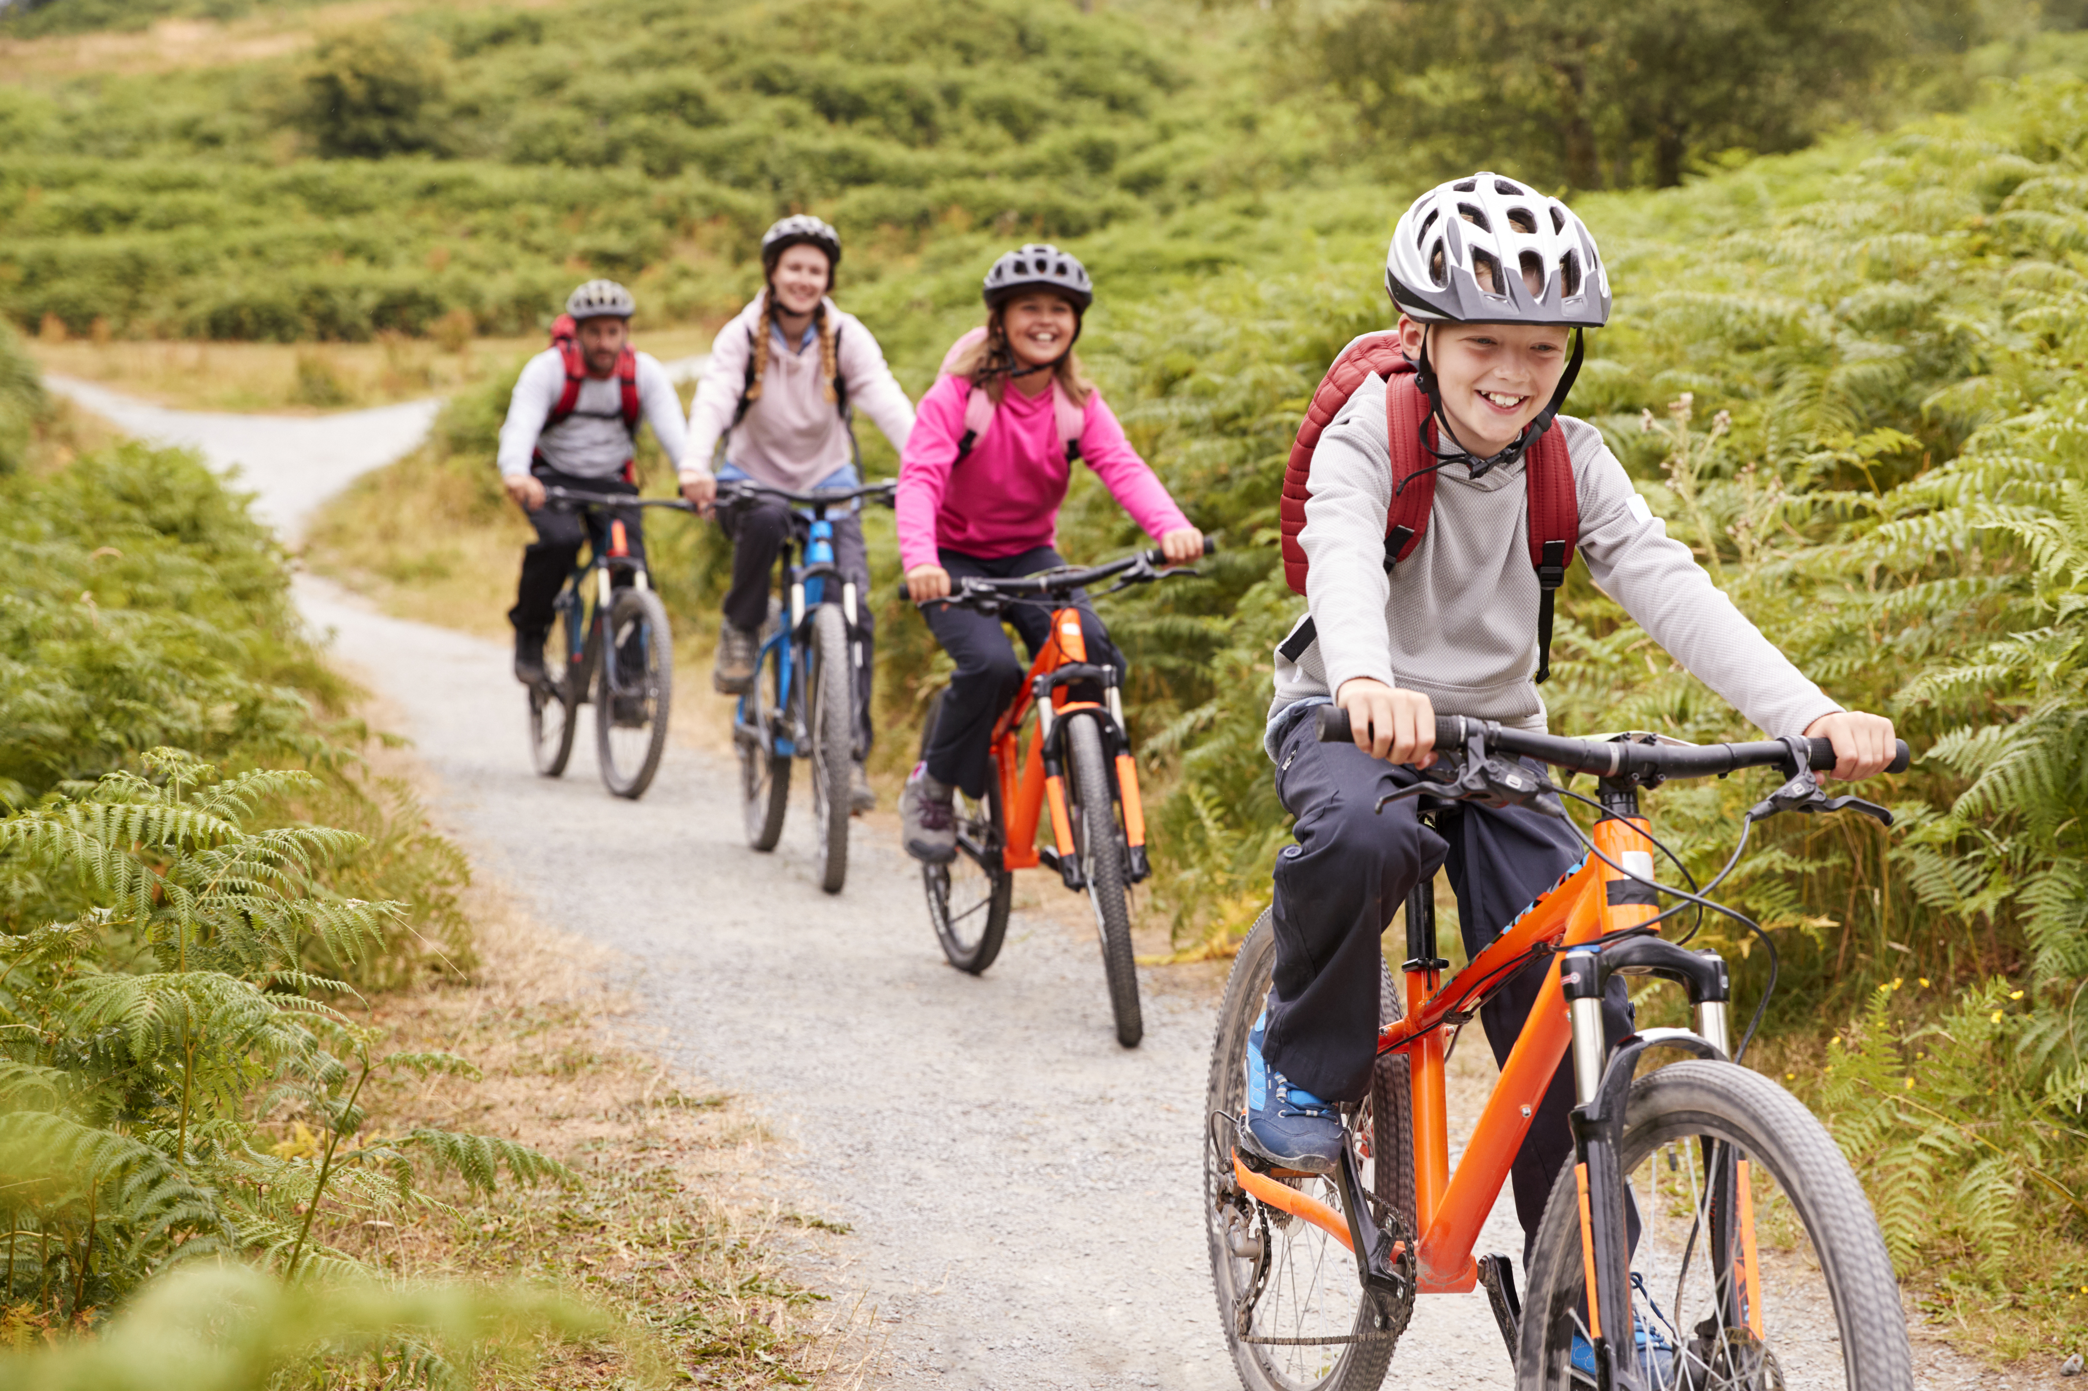
Be curious: All the small things
Finishing a tough exercise session.
©VotesforSchools2023
Notes:
Images
iStock
Microsoft Fluent Emoji – Via Emojipedia

Slide 13
Be curious: All the small things
Satisfying a craving.
©VotesforSchools2023
Notes:
Images
Unsplash
Microsoft Fluent Emoji – Via Emojipedia

Slide 14
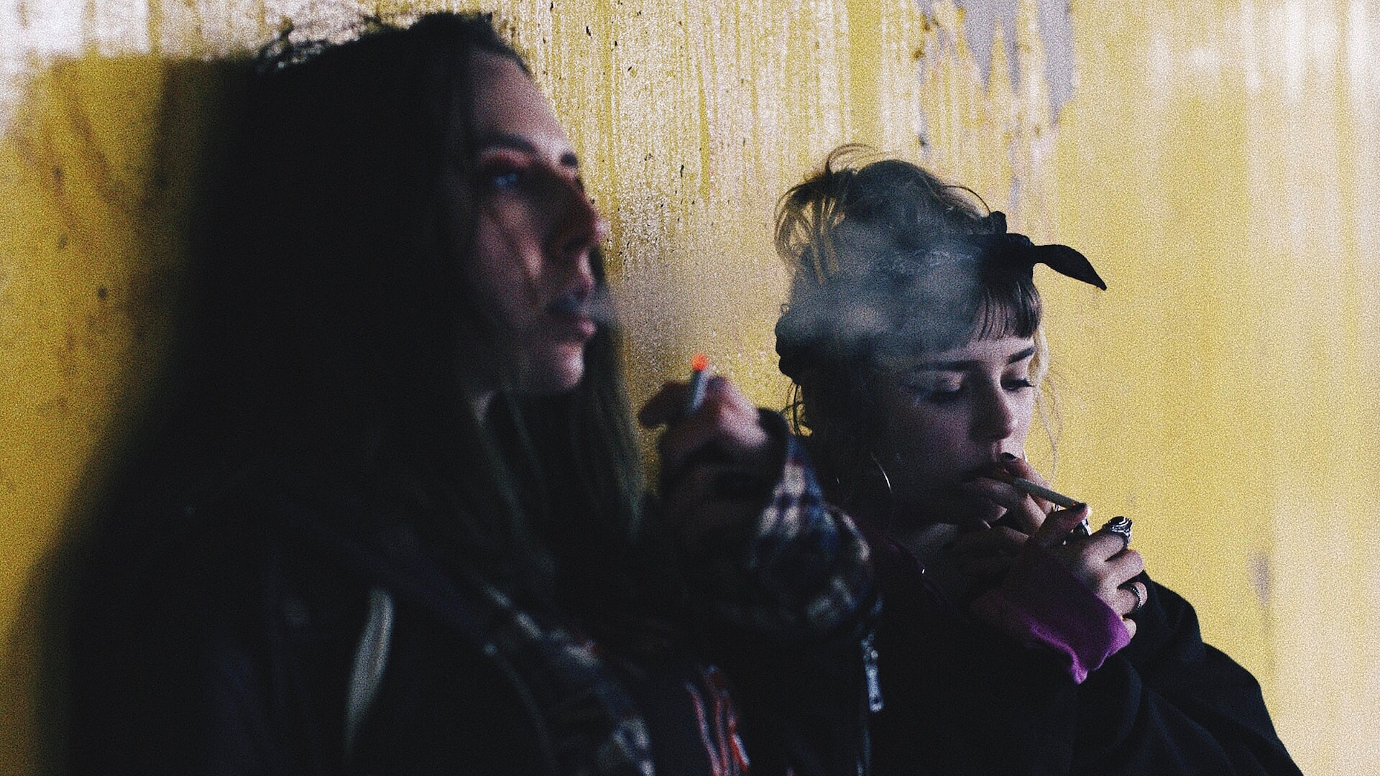
Be curious: All the small things
Each of the activities we have just seen can affect the chemicals in our bodies. This can then affect our feelings.
Addictive substances like sugar, alcohol and nicotine may make people feel good for a while, but this can come at a price.
Addictive:
Something that you cannot easily stop taking once you have started.
It’s natural to crave feeling good, but we have to be a little careful if we become dependent on things to get that rush.
Notes:
Images
Unsplash
References
https://dictionary.cambridge.org/dictionary/english/addictive

Slide 15
Be heard: Because I’m happy
Understanding more about how our bodies work can help us understand where our emotions come from.
This can also be important in understanding why things that are bad for us may, for a short while, make us happy.
A closing thought…
Is there something that affects your emotions that you think you need to understand better?
Notes:
Images
Unsplash
References
https://

Slide 16
We don’t know what the future harm could be. They used to say smoking was healthy!
This week, you are discussing:
It’s good that some people have taken up vaping and stopped smoking.
Should we be worried about vaping?
There’s better things to spend money on than stuff that goes up in smoke.
It doesn’t seem the health effects are as bad as smoking. That’s a plus.
To find out more about this topic, check out the 15 Minute and 45 Minute Lessons. For more about VotesforSchools, head to the next slide.
©VotesforSchools2023

Slide 17
Want to get involved?
Did you enjoy this assembly?
VotesforSchools creates award-winning weekly resources that meet PSHE, SMSC, British Values & Prevent curriculum aims.
To see how this lesson met the different curriculum aims, download our curriculum maps:
English & Welsh Curriculum Map
Scottish Curriculum Map
Want to take part in weekly debates?
To find out what the whole VotesforSchools package includes, and how it can help your school:
Book a demo
Contact us
©VotesforSchools2023
Notes:
Images
https://icons8.com

