Slide 1
VotesforSchools Lesson Plan: Primary 7-11 Do we know enough about how vaping affects us?
5-10 mins | 1. What is vaping? | Whole class | Voters are presented with different pieces of information about vaping. Voters decide whether they know the fact already (stand up) or don’t know the fact (sit down).
3-5 mins | 2. Why are we talking about this? | Whole class | Voters are introduced to this week’s VoteTopic.
5-10 mins | 3. Seeing through the mist… | Whole class | Voters look at different facts from a study conducted by Action on Smoking and Health (ASH). Voters fill in the blank for each fact using the multiple-choice answers provided. They show their answers using their fingers.
5-10 mins | 4. What’s the harm? | Whole class | Voters are presented with letters from three different young people who have an issue around vaping. Voters discuss the advice they would give to each person with a partner, using the prompts to support them.
5-10 mins | 5. Final thoughts! | Whole class | Voters reflect on the VoteTopic question and decide whether they feel they know enough about vaping and the how it affects them.
N/A | Vote! | Whole class | Voters review the Yes/No arguments for this topic before casting their vote.
Keywords:
Vape
Vapour
Addictive
Learning objectives:
To understand what vaping is.
To consider whether we know enough about how vaping affects us.
Cross curricular opportunities in this box
Supporting materials for SEND learners in this box
Challenge tasks in this box

Slide 3
Coming up this week…
Your learning objectives:
To understand what vaping is.
To consider whether we know enough about how vaping affects us.
Your key words:
Vape:
To breathe in nicotine as vapour rather than as smoke using an e-cigarette.
Vapour:
Extremely small drops of liquid caused by liquid being heated.
Addictive:
It can be hard to stop using something once you’ve started.
Notes:
Images
1)Icons8.com
References
https://dictionary.cambridge.org/dictionary/english/vapour
https://www.talktofrank.com/drug/vapes
https://dictionary.cambridge.org/dictionary/english/vape

Slide 4
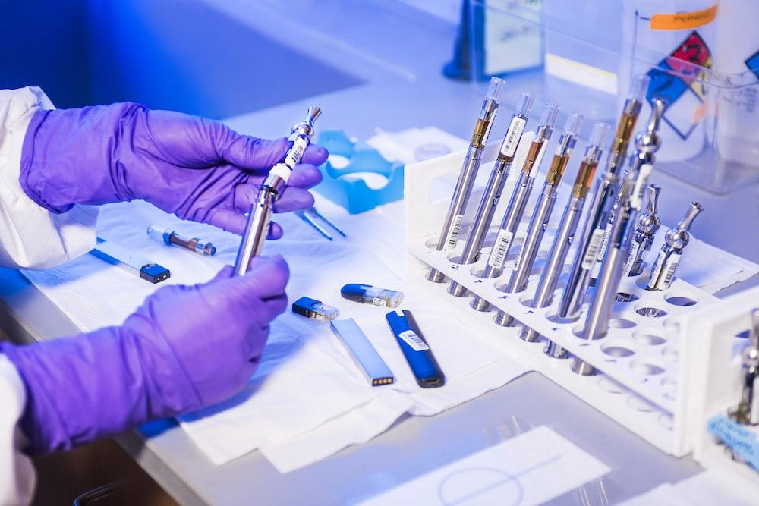
This week’s VoteTopic
Do we know enough about how vaping affects us?
©VotesforSchools2023
Notes:
Images
Unsplash

Slide 5
What is vaping?
Why are we talking about this?
Seeing through the mist…
What’s the harm?
Final thoughts!
Vote!

Slide 6
What is vaping?
Vaping is recommended by the NHS to help adults stop smoking. However, it is not recommended for anyone who is a non-smoker, especially children and young people under 18.
Whole class activity (5-10 mins)
Over the next few slides, you will be shown some information to learn more about vaping. Read each statement and then decide whether you did or didn’t know each fact. If you did, stand up. If you didn’t, sit down.
I didn’t know this fact!
I did know this fact!
Notes:
Images
iStock
References
https://www.nhs.uk/live-well/quit-smoking/using-e-cigarettes-to-stop-smoking/
https://www.talktofrank.com/drug/vapes#the-risks

Slide 7
What is vaping?
Did you know?
Adults are not allowed to buy vapes for anyone under 18.
In the UK, vapes cannot be sold to anyone under 18 years old.
Did you know this fact?
Notes:
Images
Unsplash
iStock
References
https://www.nhs.uk/live-well/quit-smoking/using-e-cigarettes-to-stop-smoking/
https://www.talktofrank.com/drug/vapes#the-risks

Slide 8
What is vaping?
Addictive:
It can be hard to stop using something once you’ve started.
Vapes contain nicotine, which is addictive.
Did you know this fact?
Notes:
Images
Unsplash
iStock
References
https://www.gov.uk/government/publications/teacher-training-drugs-alcohol-and-tobacco
https://www.talktofrank.com/drug/vapes

Slide 9
What is vaping?
Vapour:
Extremely small drops of liquid made by liquid being heated.
People inhale nicotine through vapour instead of smoke.
Did you know this fact?
Notes:
Images
Unsplash
iStock
References
https://dictionary.cambridge.org/dictionary/english/vapour
https://www.nhs.uk/live-well/quit-smoking/using-e-cigarettes-to-stop-smoking/

Slide 10
What is vaping?
Did you know?
The long-term effects of vaping are not yet known.
Vaping is considered safer than smoking, but it is not completely risk free.
Did you know this fact?
Notes:
Images
Unsplash
iStock
References
https://www.nhs.uk/live-well/quit-smoking/using-e-cigarettes-to-stop-smoking/

Slide 11
What is vaping?
The vapour contains some potentially harmful chemicals found in cigarette smoke, but at a much lower level.
Did you know this fact?
Notes:
Images
Unsplash
iStock
References
https://www.nhs.uk/live-well/quit-smoking/using-e-cigarettes-to-stop-smoking/

Slide 12
What is vaping?
Why are we talking about this?
Seeing through the mist…
What’s the harm?
Final thoughts!
Vote!

Slide 13
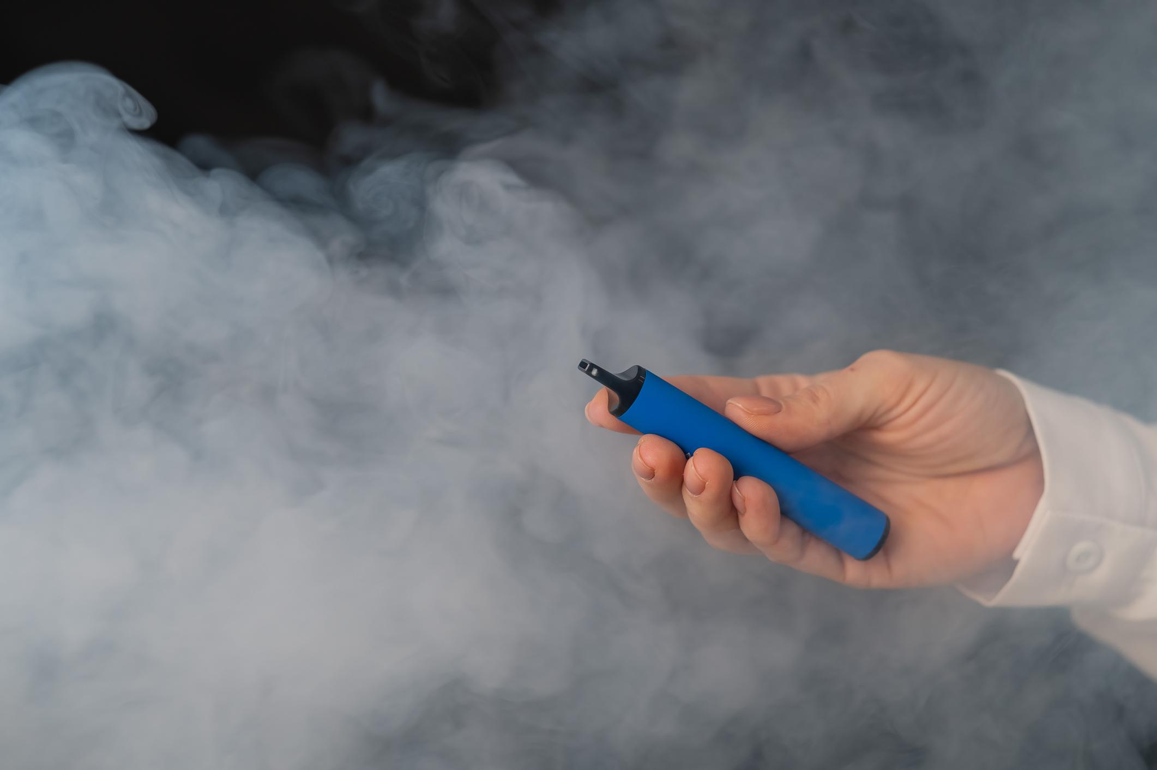
Why are we talking about this?
In recent years, vapes have become more popular.
In particular, the amount of 11-17-year olds using vapes has gone up by 3% in 1 year.
Challenge:
Remember, anyone under 18 is not allowed to buy vapes. Why do you think this is?
©VotesforSchools2023
Notes:
Images
1) iStock
References
https://ash.org.uk/resources/view/use-of-e-cigarettes-among-young-people-in-great-Britain
https://www.nhs.uk/live-well/quit-smoking/using-e-cigarettes-to-stop-smoking/

Slide 14
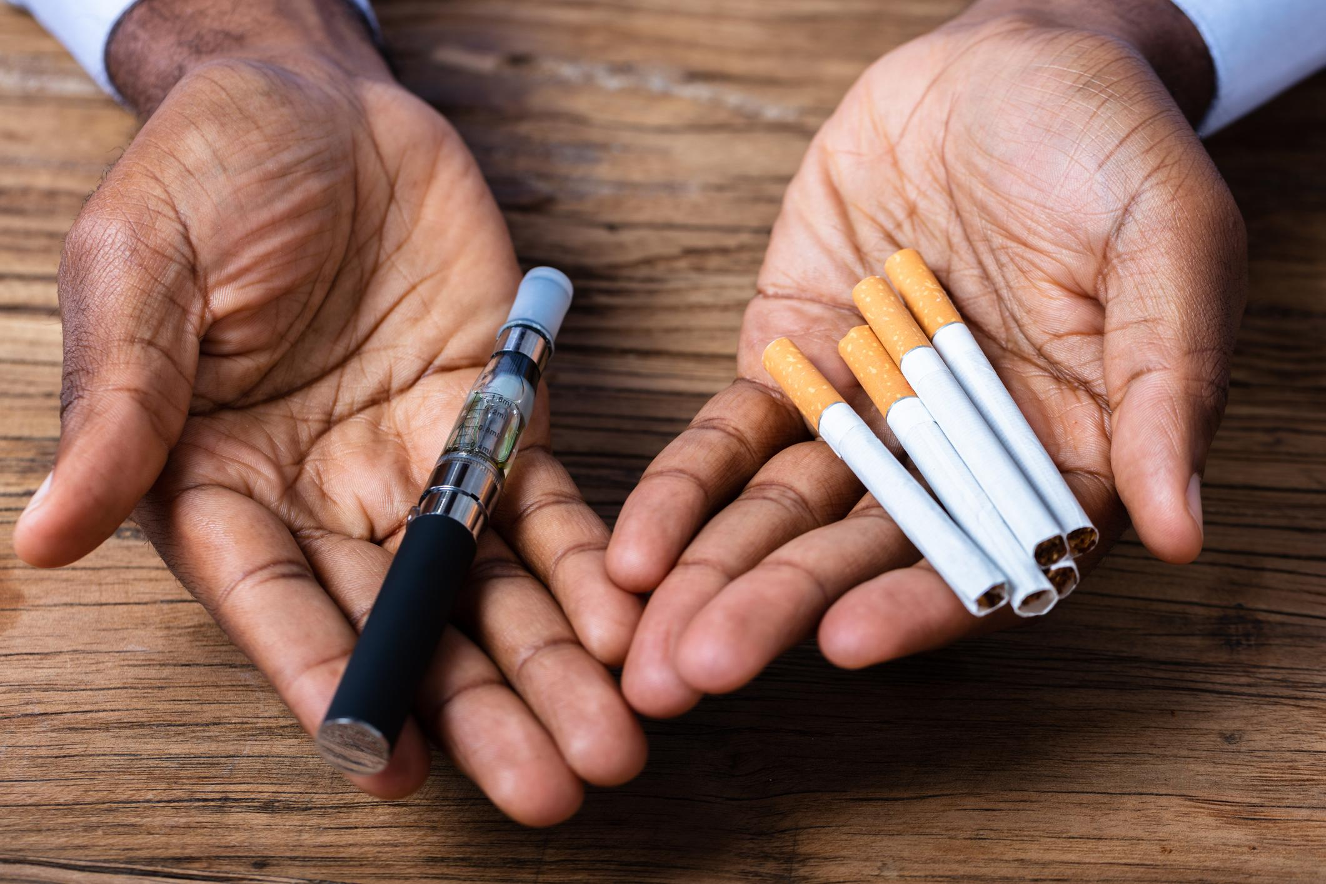
Why are we talking about this?
Some people are worried that the long-term effects of vaping could be dangerous.
Others think vapes, which are checked for quality and safety in the UK, are useful because they are helping people to stop smoking.
But do we know enough about how vaping affects us? Let’s find out!
©VotesforSchools2023
Notes:
Images
1)iStock
References
https://ash.org.uk/resources/view/use-of-e-cigarettes-among-young-people-in-great-Britain
https://www.nhs.uk/live-well/quit-smoking/using-e-cigarettes-to-stop-smoking/

Slide 15
What is vaping?
Why are we talking about this?
Seeing through the mist…
What’s the harm?
Final thoughts!
Vote!

Slide 16
Seeing through the mist…
Action on Smoking and Health (ASH) surveyed young people aged 11-18 to find out more about vaping.
Whole class activity (5-10 mins)
Over the next few slides, you will see some facts about vaping that ASH found out. For each one, use the multiple choice answers to fill in the blanks.
Use your fingers to show your answer!
©VotesforSchools2023
Notes:
Images
iStock
Pixabay

Slide 17
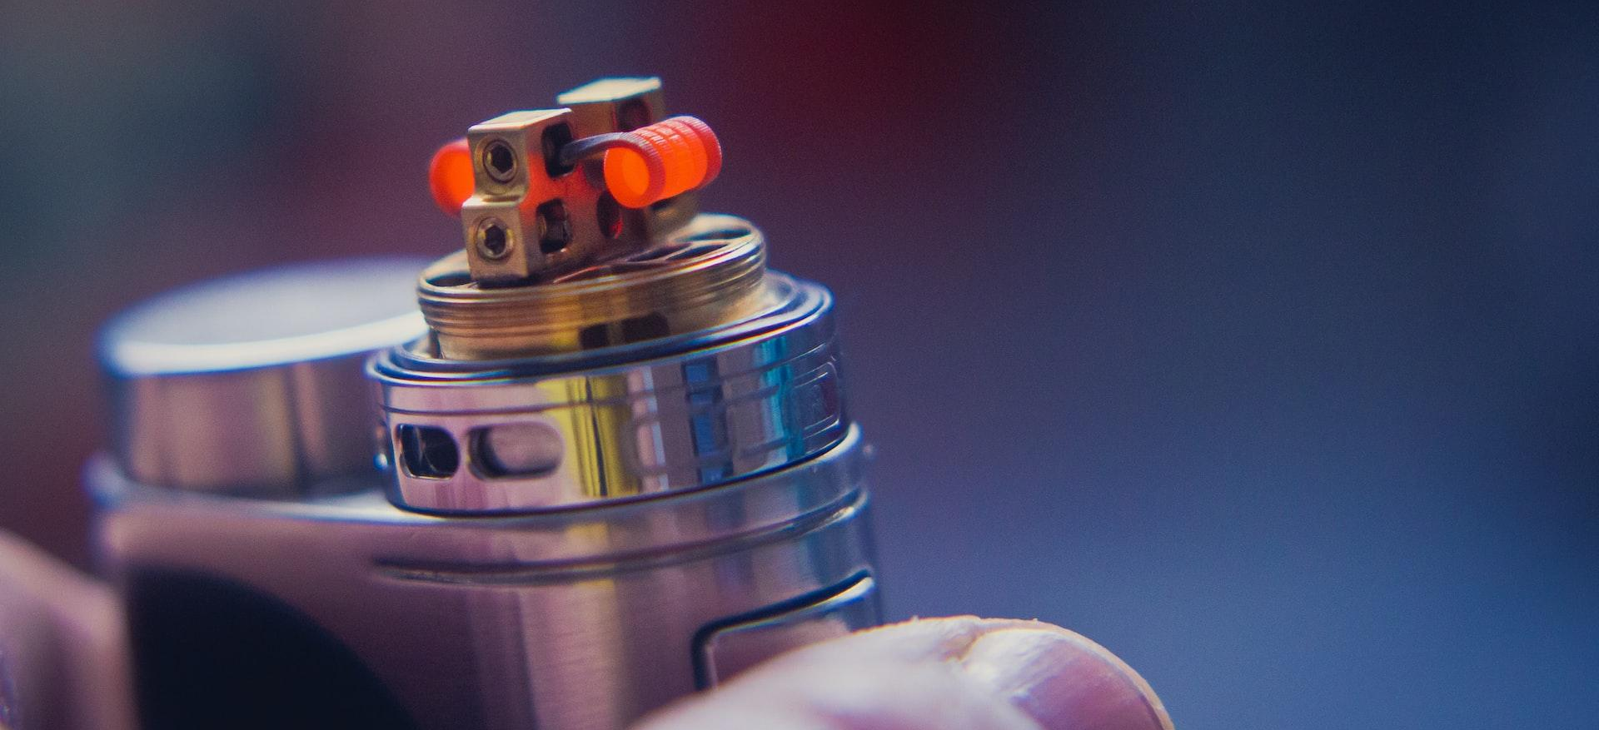
Please Note:
Under-18s are not allowed to buy or be bought vapes.
Seeing through the mist…
_____ of 11-17-year olds have never tried or are unaware of vaping.
83%
23%
53%
83%
Notes:
Images
Pixabay
Unsplash
References
https://ash.org.uk/resources/view/use-of-e-cigarettes-among-young-people-in-great-britain

Slide 18
Please Note:
Under-18s are not allowed to buy or be bought vapes.
Seeing through the mist…
Children under ____ are least likely to try vaping.
16
15
16
17
Notes:
Images
Unsplash
Pixabay
References
https://ash.org.uk/resources/view/use-of-e-cigarettes-among-young-people-in-great-britain

Slide 19
Please Note:
Under-18s are not allowed to buy or be bought vapes.
Seeing through the mist…
So far in 2022, ____ of 11-17-year olds currently use vapes.
7%
7%
17%
27%
Notes:
Images
iStock
Pixabay
References
https://ash.org.uk/resources/view/use-of-e-cigarettes-among-young-people-in-great-britain

Slide 20
Seeing through the mist…
Among 18-year olds, _____ have tried vaping.
40%
30%
40%
50%
Notes:
Images
iStock
Pixabay
References
https://ash.org.uk/resources/view/use-of-e-cigarettes-among-young-people-in-great-britain

Slide 21
Seeing through the mist…
Did you know?
There are currently around 6 million people who smoke in England.
There are currently _____ million people who vape in England.
3.8
3.8 million
4.8 million
5.8 million
Notes:
Images
iStock
Pixabay
References
1) https://www.itv.com/news/2022-09-29/curb-vape-sales-to-children-due-to-potential-risks-experts-urge

Slide 22
What is vaping?
Why are we talking about this?
Seeing through the mist…
What’s the harm?
Final thoughts!
Vote!

Slide 23
What’s the harm?
Partner activity (5-10 mins)
You’re now going to read letters from three young people about vaping. As a
class, read each letter and discuss what advice you would give to each young person. Use the stamps below to help guide your discussion!
Remember the rules
Talk to a trusted adult
Ask questions
Speak out
It’s important to remember that anyone under 18 is not allowed to buy or be bought vapes.
Talk to a trusted adult about any concerns you have about vaping.
If you have questions about vaping, speak to a trusted adult.
If people don’t feel comfortable doing something, it’s okay for them to say no.
©VotesforSchools2023
Notes:
Images
Pixabay
References
1) https://www.childline.org.uk/info-advice/friends-relationships-sex/friends/peer-pressure/

Slide 24
What’s the harm?
What advice would you give?
I’m worried that people will judge my mum for vaping. She’s trying really hard to stop smoking, and I don’t want people to be mean to her.
From Akeel (aged 8)
©VotesforSchools2023
©VotesforSchools2023
Notes:
Images
Pixabay

Slide 25
Please Note:
Under-18s are not allowed to buy or be bought vapes.
What’s the harm?
What advice would you give?
I saw a vape on the ground on the way to school this morning. I thought it looked really cool and just like a toy. I might pick it up on my way back home.
From Natasha (aged 9)
©VotesforSchools2023
Notes:
Images
Pixabay

Slide 26
Please Note:
Under-18s are not allowed to buy or be bought vapes.
What’s the harm?
What advice would you give?
My friend found his brother’s vape and is daring me to try it. I really don’t want to as I know I’m too young to vape!
From Leon (aged 11)
©VotesforSchools2023
Notes:
Images
Pixabay

Slide 27
What is vaping?
Why are we talking about this?
Seeing through the mist…
What’s the harm?
Final thoughts!
Vote!

Slide 28
Final thoughts!
Individual reflection (1-2 mins)
Look at the thought bubbles below. Which point of view do you agree with?
We know enough about how vaping affects us.
We don’t know enough about how vaping affects us.
Across the curriculum – Spoken language:
Debate your ideas as a class. Be sure to listen and respond respectfully.
Notes:
Images
iStock
Pixabay

Slide 29
What is vaping?
Why are we talking about this?
Seeing through the mist…
What’s the harm?
Final thoughts!
Vote!

Slide 30
Vote!
Vaping is less harmful than smoking.
In the UK, vapes are regulated for quality and safety.
Vaping can help people to stop smoking.
Do we know enough about how vaping affects us?
Vaping is not completely risk free. The long-term effects of vaping are not known.
The vapour contains some potentially harmful chemicals found in cigarette smoke, but at a lower level.
Vapes still contain nicotine, which can be addictive.
Head to the next slide to find out what children & young people had to say about this topic and who we shared the results with!
©VotesforSchools2023

Slide 31
How do your results compare?
42,907 children & young people got involved in the national conversation!
“Yes I do because my dad works at the vape shop so I think I know about the effects.”
Primary school,
West Midlands
“We don't actually know how much safer vaping is. If you don't know why would you risk it?”
Estcourt Primary Academy
Primary school, Yorkshire
Yes
No
39.8%
60.2%
We went on to share voters’ comments with…
©VotesforSchools2023
Notes:
Images
https://en.wikipedia.org/wiki/Childline
https://en.wikipedia.org/wiki/Public_Health_England
https://ash.org.uk/
https://www.healthyschools.org.uk/
https://en.wikipedia.org/wiki/Mumsnet

Slide 32
Want to get involved?
Did you enjoy this lesson?
VotesforSchools creates award-winning weekly resources that meet PSHE, SMSC, British Values & Prevent curriculum aims.
To see how this lesson met the different curriculum aims, download our curriculum maps:
English & Welsh Curriculum Map
Scottish Curriculum Map
Want to take part in weekly debates?
To find out what the whole VotesforSchools package includes, and how it can help your school:
Book a demo
Contact us
©VotesforSchools2023
Notes:
Images
https://icons8.com

