Slide 1





Make Your Voice Count
pupilvoiceweek.co.uk #pupilvoiceweek

Slide 2


Objectives
• To recognise the value of our voices
• To build confidence in speaking up
• To be comfortable promoting ourselves and other people
• To identify how our voices can change our world

Slide 3

The value of your voice
They say ‘silence is golden’. But there are times in life where it’s far more important to make your voice heard.
Whether it’s asking for help; instructing others; protesting or debating; having a job interview; or working with other people.
Your voice has the potential to create positive change. For yourself and the world around you.

Slide 4
Name an occupation where the voice is important...

Slide 5




Name an occupation where the voice is important
Solicitor
Teacher
Police Officer
Doctor

Slide 6
When has your voice helped you or others?

Slide 7
When has your voice helped you or others?
  Getting a part-time job?
  Completing a homework assignment?
  Learning a second language?
  Supporting a friend?
  Giving directions to someone who’s lost?
  Acting, singing or playing sports?

Slide 8
But some people aren’t as comfortable using their voice as others
How can we build our confidence in using our voices?
  Think positively
  Practice speaking in front of a parent, sibling or friend
  Play games that require speaking
  Make a list of your achievements and qualities
  Positive affirmations

Slide 9

Embrace your qualities!
Another way you can boost your confidence is by considering your strengths and achievements. What qualities could you have?
•Academic
•Sports and Hobbies
•Personality Traits
•Achievements
•Specialist Knowledge
Make a list to help you identify as many qualities as you can. Refer to it whenever you need reminded how awesome you are!

Slide 10
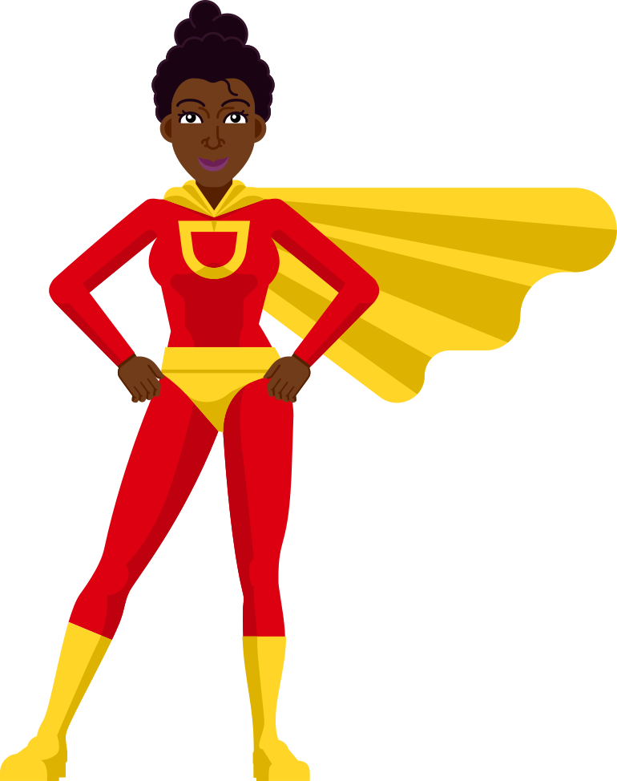
10 Reasons to Acknowledge Your Strengths
  Self-confidence
  Positive Mindset
  Motivation
  Resilience
  Improved Relationships
  Personal Growth
  Reduce Self-Criticism
  Stress Reduction
  Empowerment
  Inspiration to Others

Slide 11

You’re hired!
Many employers conduct interviews in order to assess the suitability of applicants for a job role.
Being comfortable in talking about your qualities can be very useful when it comes to job interviews.
Remember that list you made? It will come in very handy here. There’s never been a better time to blow your own trumpet!

Slide 12
So far we’ve:
•Recognised the value of our voice
•Built confidence in speaking
•Become comfortable acknowledging our strengths
Now... are you ready to change the world?

Slide 13

The Power of Words
  Advocacy and Activism
  Education and Awareness
  Inspiration and Motivation
  Entertainment and Culture
  Mental Health and Wellbeing
  Innovation and Collaboration
  Political Engagement
  Conflict Resolution and Peacebuilding
  Empathy and Connection
  Parenting and Education

Slide 14

Asking for help
Sometimes we need to use our voices to ask for help or explain a problem to someone.
Talking about anything that’s troubling you can help you feel better about things, which in turn can help you feel more confident and happier in general.
In doing so, you may find others share the same concern, which might help you feel less alone with your problem.

Slide 15

Who can we talk to?
If you have anything you need to talk about, remember you can talk to…
• A friend
• A parent
• A teacher
• tootoot

Slide 16
What is tootoot?
•You can use tootoot to talk about anything that is making you feel unhappy or unsafe, no matter how big or small.
•It is anonymous!
•Your message goes through to a trusted teacher who will help you.
•You can login to tootoot at yourschoolname.tootoot.co.uk or download the app!
•If you can’t remember your login please speak to teachersname who will help you reset it.

Slide 17
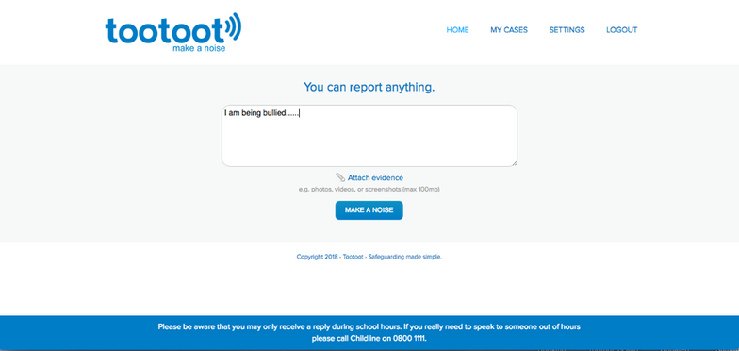
What is tootoot?

Slide 18
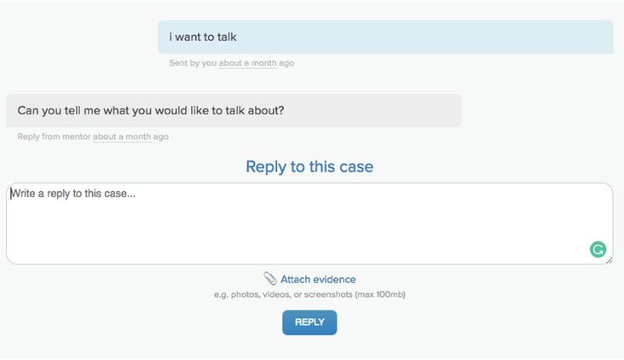
What is tootoot?

Slide 19
Any questions?
pupilvoiceweek.co.uk #pupilvoiceweek

Slide 20
Thank you!
pupilvoiceweek.co.uk #pupilvoiceweek

