Slide 1





Make Your Voice Count
pupilvoiceweek.co.uk #pupilvoiceweek

Slide 2


Objectives
• To understand the value of our voices
• To become more confident in speaking
• To identify and talk about our qualities
• To explore how our voices can change our world

Slide 3

The value of your voice
They say ‘silence is golden’. But there are times in life where it’s far more important to make your voice heard.
Your voice can positively impact your own life, the lives of others and the whole world.

Slide 4
Name an occupation where the voice is important...

Slide 5


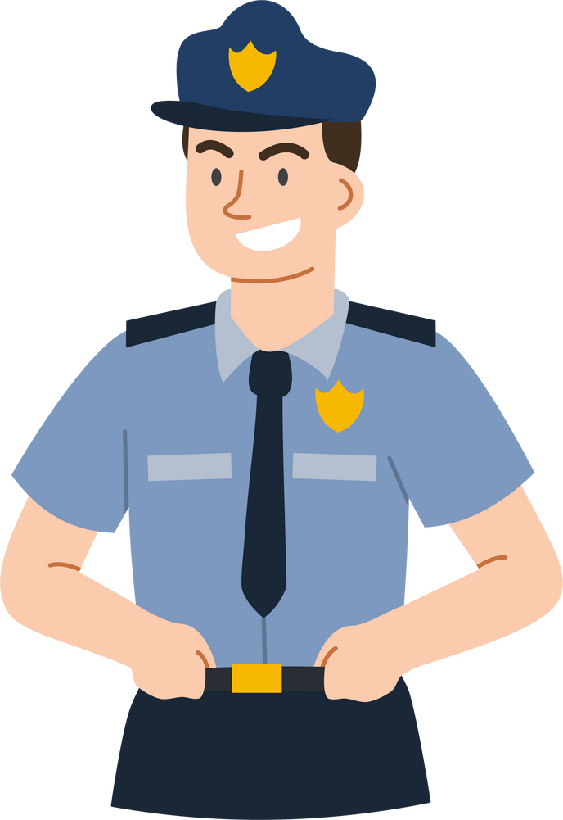

Name an occupation where the voice is important
Solicitor
Teacher
Police Officer
Doctor

Slide 6
When has your voice helped you or others?

Slide 7
When has your voice helped you or others?
  Doing your homework?
  Learning a second language?
  Supporting a friend?
  Acting, singing or playing sports?
  Asking for help?

Slide 8
But I’m very shy. I don’t like talking.
How can we become more confident in using our voices?
  Think positively
  Practice speaking in front of a parent, sibling or friend
  Play games that require speaking

Slide 9

Embrace your qualities!
Another way you can boost your confidence is by considering your strengths and achievements. What qualities could you have?
•Academic
•Sports and Hobbies
•Personality Traits
•Achievements
•Specialist Knowledge
Make a list to help you identify as many qualities as you can. Refer to it whenever you need reminded how awesome you are!

Slide 10
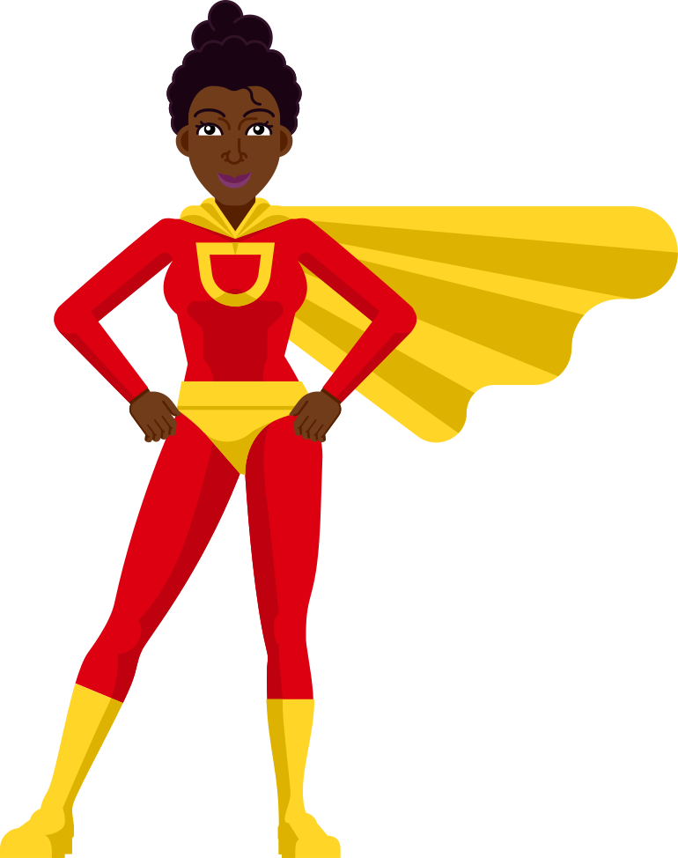
6 Reasons to Acknowledge Your Strengths
  Self-confidence
  Motivation
  Resilience
  Personal Growth
  Stress Reduction
  Inspiration to Others

Slide 11

You’re hired!
Being comfortable in talking about your qualities can be very useful when it comes to job interviews.
Remember that list you made? It will come in very handy here. There’s never been a better time to talk about your qualities!

Slide 12
So far we’ve:
•Understood the value of our voice
•Built confidence in speaking
•Identified our strengths
Now... are you ready to change the world?

Slide 13
The Power of Words
  Raising Awareness
  Inspiring Others
  Entertainment
  Mental Health and Wellbeing
  Working Together
  Parenting and Teaching

Slide 14
Asking for help
One of the most important things we can use our voices for is asking for help.
Talking about things that are concerning you, or asking for help with a problem can help you feel much better about things.
You may also find other people who share the same concern or problem!

Slide 15

Who can we talk to?
If you have anything you need to talk about, remember you can talk to…
• A friend
• A parent
• A teacher
• tootoot

Slide 16
What is tootoot?
•You can use tootoot to talk about anything that is making you feel unhappy or unsafe, no matter how big or small.
•It is anonymous!
•Your message goes through to a trusted teacher who will help you.
•You can login to tootoot at yourschoolname.tootoot.co.uk or download the app!
•If you can’t remember your login please speak to teachersname who will help you reset it.

Slide 17
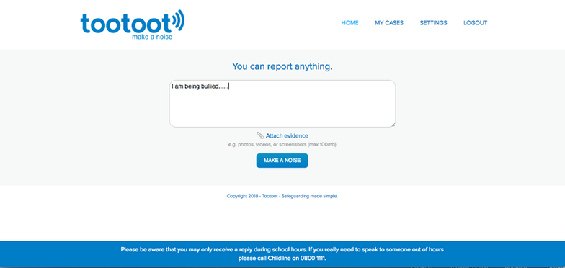
What is tootoot?

Slide 18
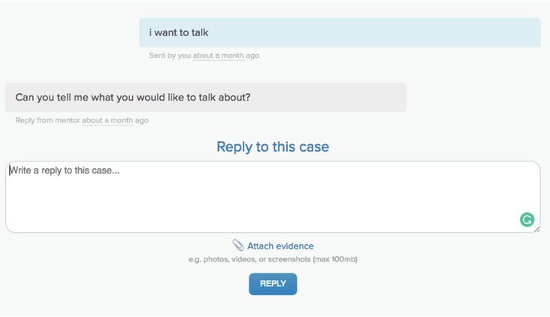
What is tootoot?

Slide 19
Any questions?
pupilvoiceweek.co.uk #pupilvoiceweek

Slide 20
Thank you!
pupilvoiceweek.co.uk #pupilvoiceweek

