Slide 1
SOLVING PROBLEMS
pupilvoiceweek.co.uk
#pupilvoiceweek

Slide 2
OBJECTIVES
To understand that problems are part of everyday life
To feel more confident in solving problems
Explore ways to solve problems
pupilvoiceweek.co.uk
#pupilvoiceweek

Slide 3
GOT PROBLEMS?
NO PROBLEM.
In life we will encounter many problems. some may be big and difficult while others may be small and easy to overcome.
We begin to develop skills in problem solving from the moment we're born. It's how we learn to grow.
But that's okay!
pupilvoiceweek.co.uk
#pupilvoiceweek

Slide 4
WHAT'S THE PROBLEM?
Points to ponder:
What kind of problems do you encounter at school?
2. What sort of problems do adults have?
3. If we feel like stuck, what could we do?
pupilvoiceweek.co.uk
#pupilvoiceweek

Slide 5
WHAT KIND OF JOBS INVOLVE SOLVING PROBLEMS?
pupilvoiceweek.co.uk
#pupilvoiceweek

Slide 6
CAN YOU SOLVE A PROBLEM WITH WORDS?
While many problems can be solved with actions, talking about problems can help you to find ways to solve them.
How words can help people solve problems:
Encouragement
Advice
Shared Experience
Direction
Instructions
Not least of all...
pupilvoiceweek.co.uk
#pupilvoiceweek

Slide 7
A PROBLEM SHARED...
...IS A PROBLEM HALVED
pupilvoiceweek.co.uk
#pupilvoiceweek

Slide 8
TALKING TO SOMEONE CAN REALLY HELP.
pupilvoiceweek.co.uk
#pupilvoiceweek

Slide 9
ASKING FOR HELP
If you have a problem that seems too big to solve:
Ask someone for help
They may know others who can help
Just talking about it can help you feel better
pupilvoiceweek.co.uk
#pupilvoiceweek

Slide 10
ASKING TO HELP
It can sometimes be difficult to ask for help.
They may feel shy, nervous, or embarrassed
If you are aware of someone who is struggling with a problem, ask if there's anything you can do to help
Even just by listening to them, you might be helping them in a really big way!
pupilvoiceweek.co.uk
#pupilvoiceweek

Slide 11
IT'S IMPORTANT FOR THE MENTAL HEALTH AND WELLBEING OF OUR FRIENDS, FAMILY AND SCHOOL COMMUNITY THAT WE ALL FEEL COMFORTABLE TO TALK.
pupilvoiceweek.co.uk
#pupilvoiceweek

Slide 12
HOW CAN WE SOLVE OUR PROBLEMS?
Problems can be big or small. They can last a long time or be over in a couple of minutes. So there's no single answer that would satisfy all problems.
Don't ignore them! Problems rarely go away on their own. In fact, there is a real chance they could get worse if you ignore them for too long.
But regardless what the problem is, the one thing that serves as a recommended
starting point is talking.
pupilvoiceweek.co.uk
#pupilvoiceweek

Slide 13
WHO CAN WE TALK TO?
If you have anything you need to talk about rememeber you can talk to...
Friends
Parents
Teachers
Tootoot
pupilvoiceweek.co.uk
#pupilvoiceweek

Slide 14
WHAT CAN YOU DO?
Always tell a teacher, a friend or tootoot!
Report any bullying you see - if it's cyberbullying, screenshot the evidence and send to tootoot.
Support each other, if you witness bullying or cyberbullying show some support to the individual so they don't feel alone.
pupilvoiceweek.co.uk
#pupilvoiceweek

Slide 15
WHAT IS TOOTOOT?
You can use tootoot to talk about anything that is making you feel unhappy or unsafe, no matter how big or small.
It is anonymous!
Your message goes through to a trusted teacher who will help you.
You can login to tootoot at or download the app!
If you can't remember your login please speak to who will help you reset it.
yourschoolname.tootoot.co.uk
teachersname
pupilvoiceweek.co.uk
#pupilvoiceweek

Slide 16
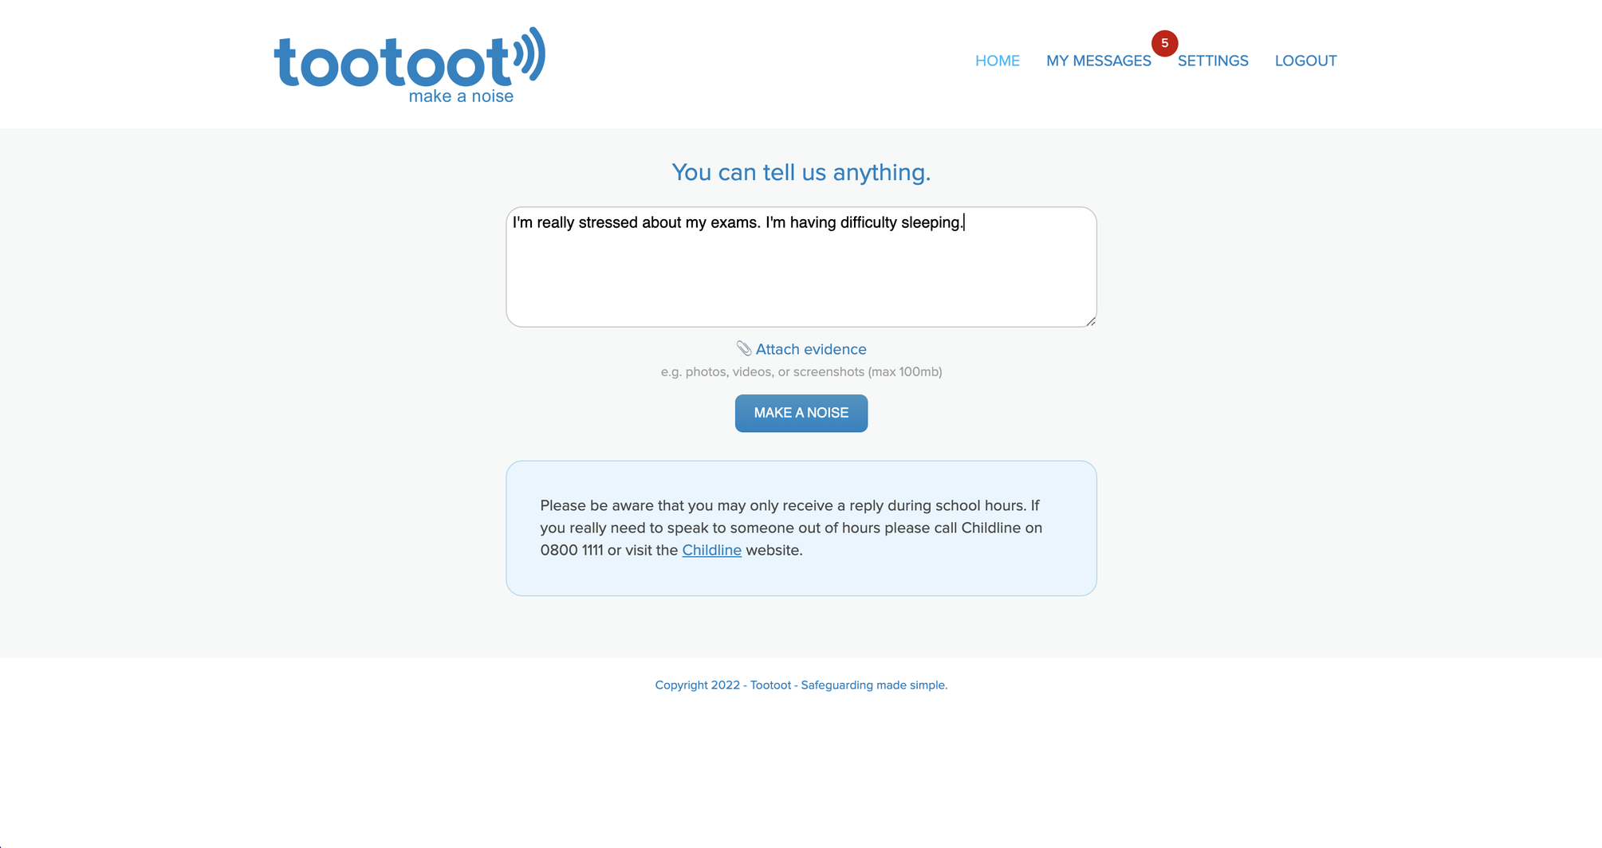
WHAT IS TOOTOOT?
pupilvoiceweek.co.uk
#pupilvoiceweek

Slide 17
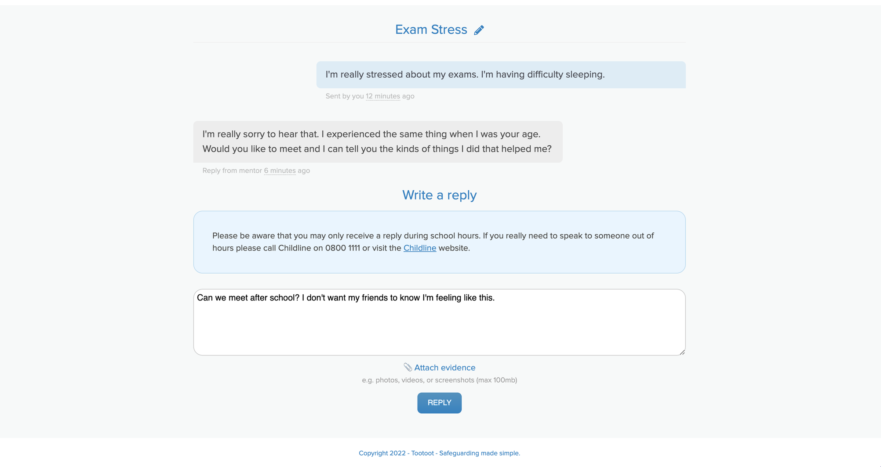
WHAT IS TOOTOOT?
pupilvoiceweek.co.uk
#pupilvoiceweek

Slide 18
THANK YOU!
pupilvoiceweek.co.uk
#pupilvoiceweek

