Slide 1
IT'S GOOD TO TALK
Pupil Voice Week 2020

Slide 2
Objective
To understand why we should always talk if we feel unhappy or unsafe.
To consider the mental wellbeing of those around us and the ways we can help them talk when they need to.

Slide 3
How many words do we speak in a day?

Slide 4
Hands up!
a. 850 b. 5,500 c.7,000

Slide 5
Answer:
c. 7,000 words!

Slide 6
Talking isn't easy for everyone, especially when it comes to talking about our mental health

Slide 7
60% of people with a mental health concern waited over a year to tell the people closest to them about it. (Time to Change)
1 in 10 children have no one to talk to in school when they are worried or sad. (Mental Health Foundation, 2018)
More than one in four children who experienced feeling worried or sad said that it caused them to struggle with their homework (Mental Health Foundation, 2018)
57% of young people hide at least one type of worry from their parents
(Action for Children, 2019)
Over a quarter of young people are worried about their own mental health (Action for Children, 2019)

Slide 8
How can we make it easier for our friends and family to talk?

Slide 9
How can you help?
There are a lot of things you can do to support someone who needs to talk:
-Check in
-Listen and don’t judge
-Treat them in the same way
-Ask 'Are you ok?' twice
(Time to Change)

Slide 10
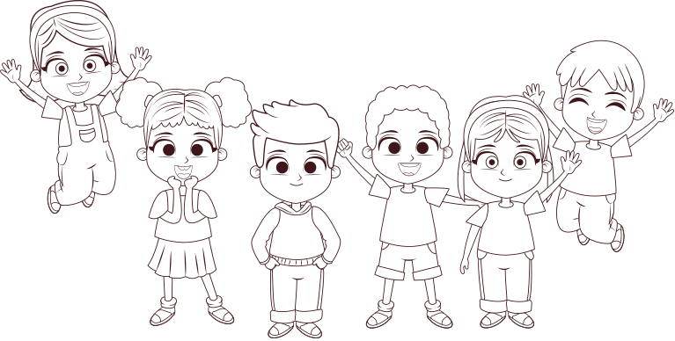
Reflection
How can we use our words more today to make ourselves and the people around us feel happier and safer?

Slide 11
Conclusion
We use a lot of words each day, how can we use them to make ourselves and others feel happy and safe?
Ask 'Are you ok?' twice, be a good listener and always treat your friends in the same way.
If you feel unhappy or unsafe, or if you're worried about a friend always talk to a teacher, a friend, a trusted adult or tootoot.

Slide 12
Thank you!
Any questions?

