Slide 1


Slide 2
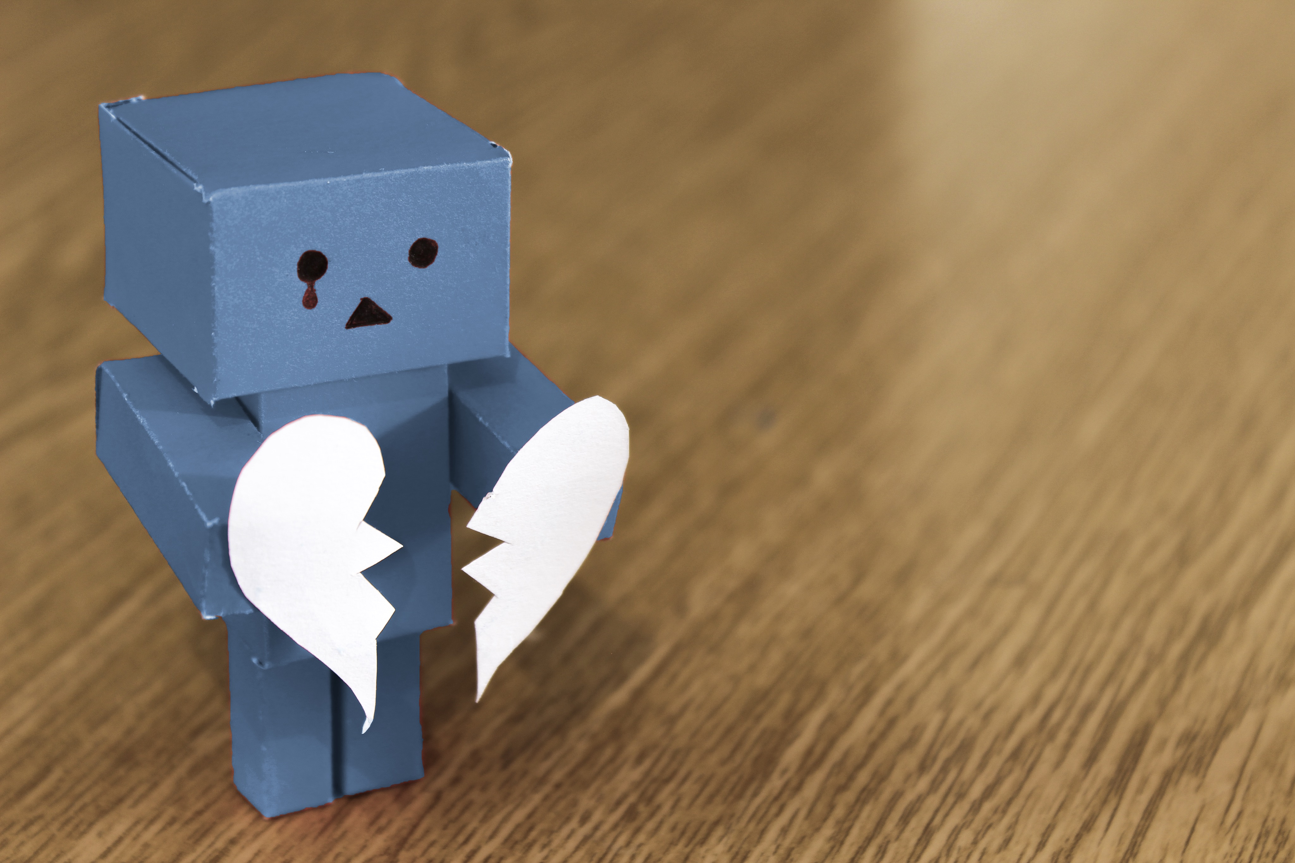
54% of children and young people have experienced bullying at some point

Slide 3
69% of children and young people have admitted to doing something mean to another person online.

Slide 4
What things might we say or do that are negative?

Slide 5
Saying something mean to someone online or in person
Deliberately excluding people during play time
Making fun of someone because they are different from you in some way
Damaging someone’s belongings

Slide 6
What things might we say or do that are positive?

Slide 7
Telling your friend when you think they have done a good job
Offering to help someone when they look like they need it
Speaking up if you see something that makes you or a friend feel unhappy or unsafe
Being kind to people when you think they might need it

Slide 8
Time for reflection…
“A person who has good thoughts cannot ever be ugly. You can have a wonky nose and a crooked mouth and a double chin and stick-out teeth, but if you have good thoughts they will shine out of your face like sunbeams and you will always look lovely.”

Slide 9
Assembly Challenge!
We are a very positive school…
My challenge to you is to find a way to ‘Use Your Voice’ to be positive in a new way this week.

Slide 10
Remember…
If there is anything that is making you or a friend feel unhappy or unsafe you can:
Tell a teacher
Tell a trusted adult
Tell tootoot!

Slide 11
Assembly Review!
People can be bullied for lots of different reasons, but it is never their fault.
We should use our voice to create positivity for those around us!
We should use our voices to speak-up for ourselves and others if we see something that is making us feel unhappy or unsafe.

