Slide 1
Self-esteem and appearance project:
‘It’s good to talk’
Positive Body Image

Slide 2

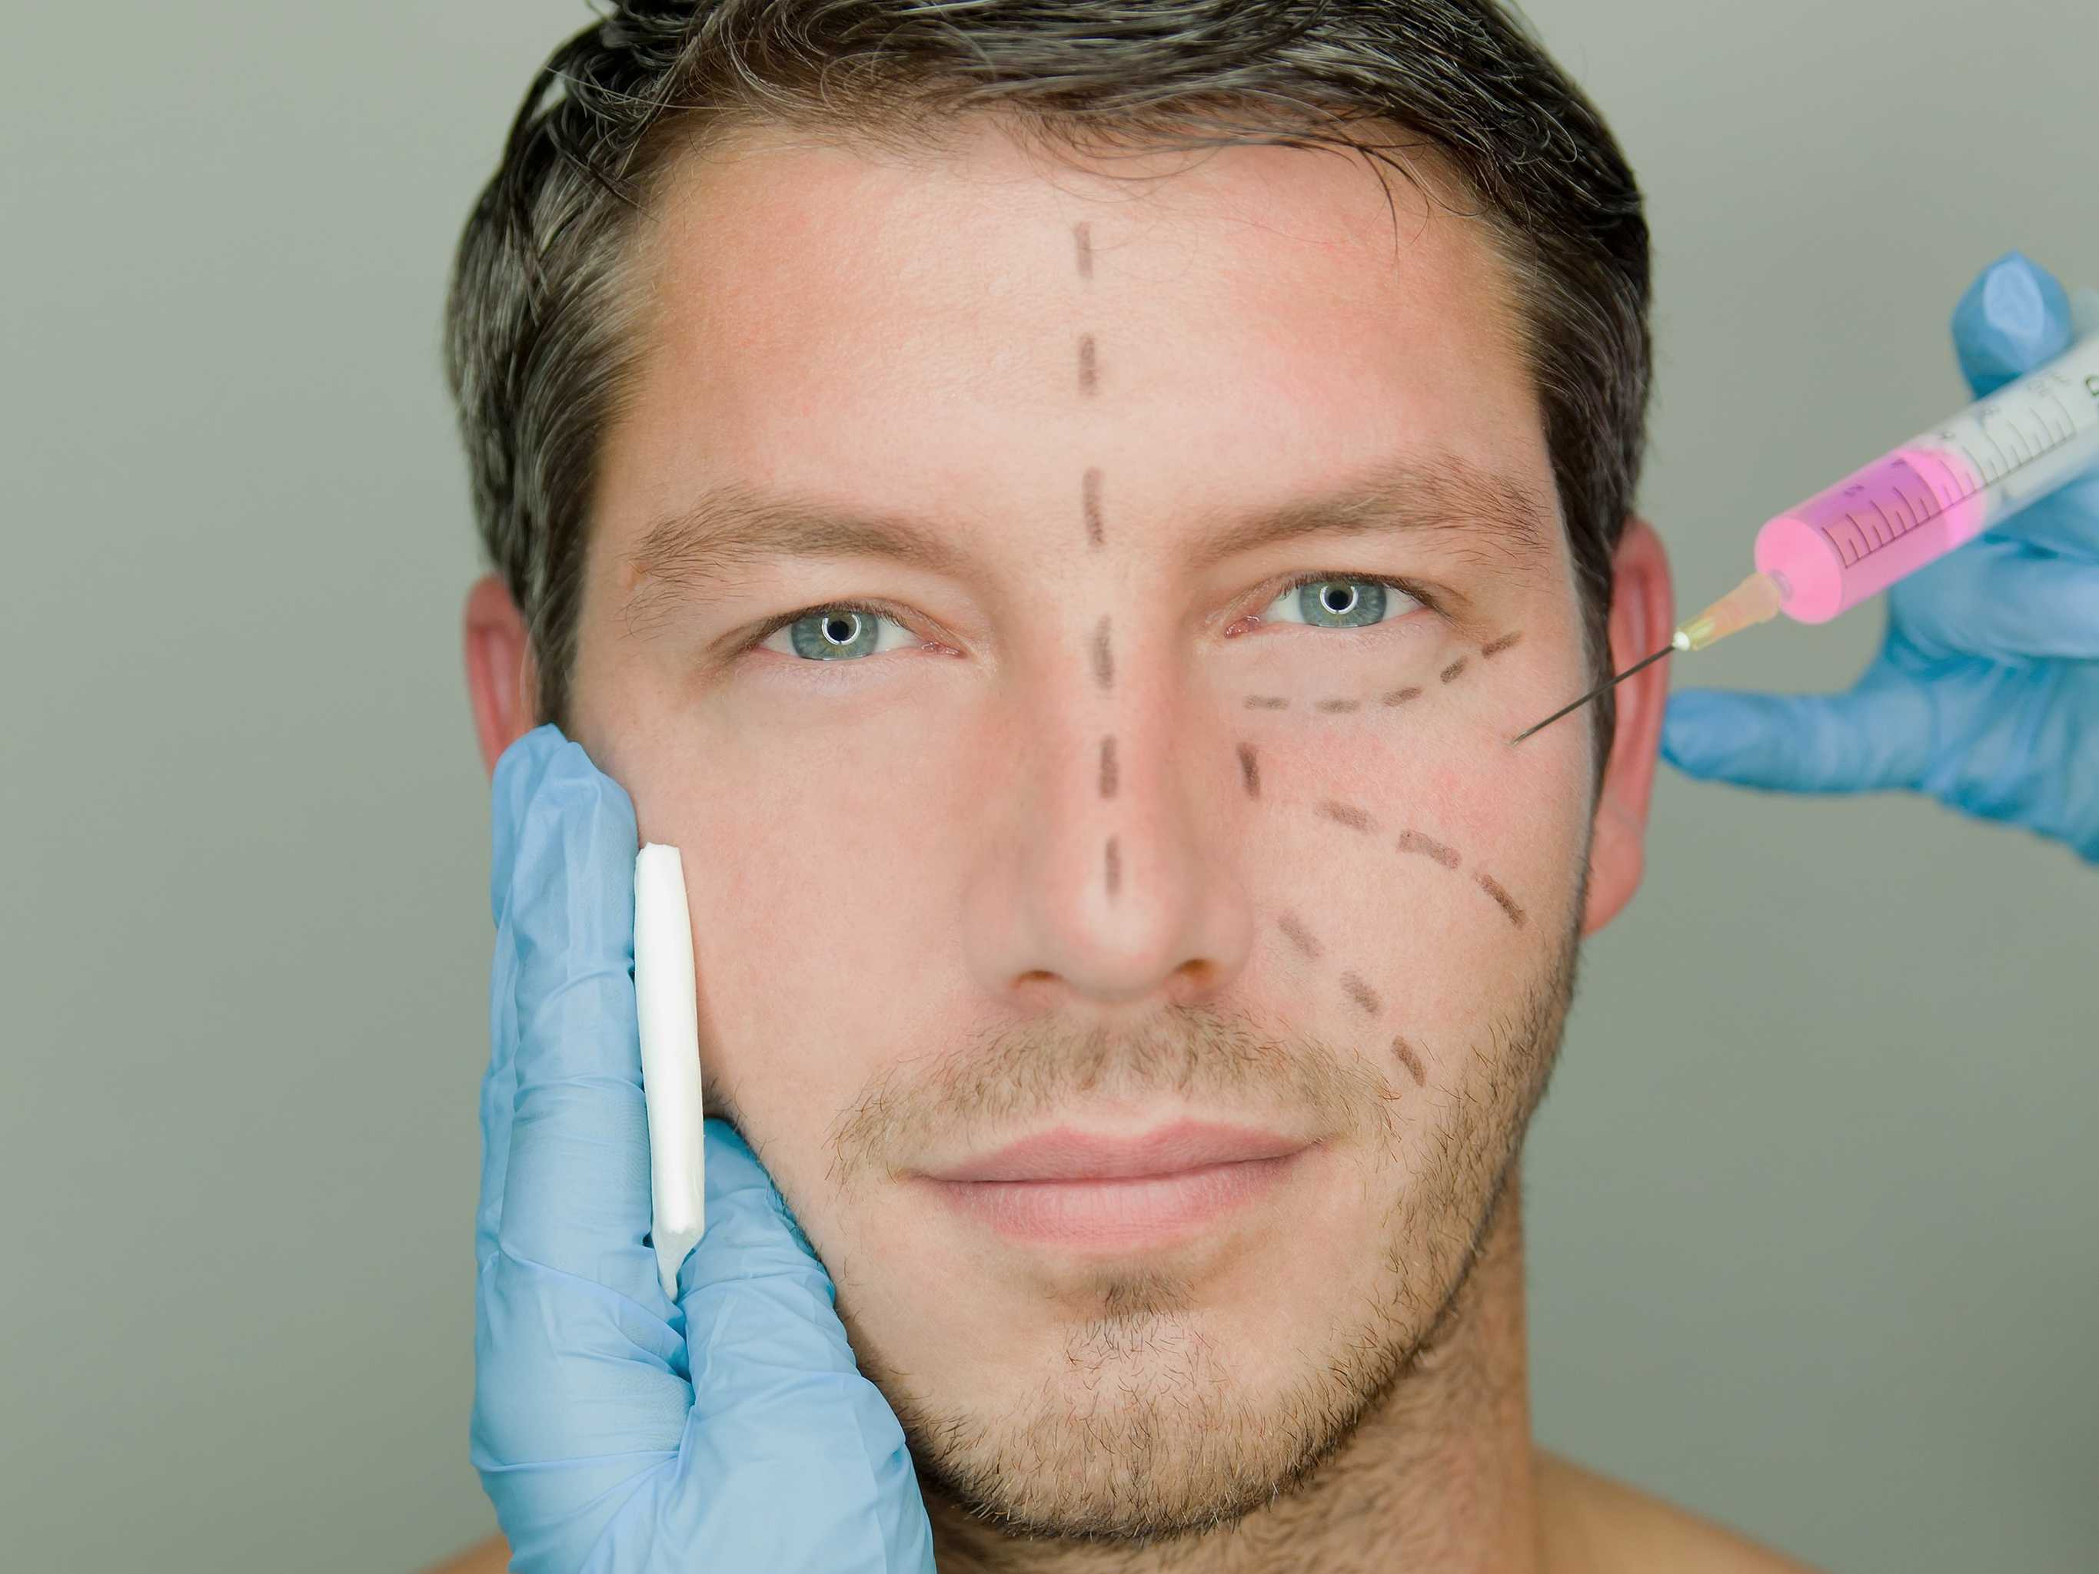
Plastic Surgery…
Nose Job
Hair transplantation
Laser Hair Removal
Breast reconstruction
Teeth Whitening
Dermabrasion
Botox
Chemical peels
Liposuction
Skin whitening
Breast Augmentation
Eyelid Surgery
Upper Arm Lift
Face Lift
Tummy Tuck
Permanent Makeup
Laser Skin Resurfacing
Buttock Augmentation

Slide 3
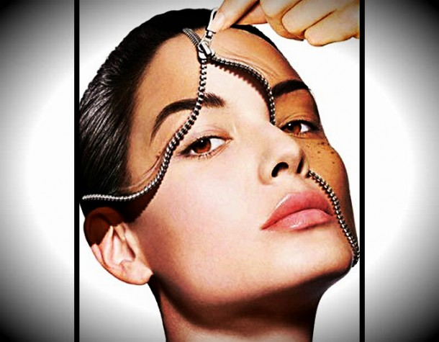
When is plastic surgery ok?
FOR
Alleviate mental health issues
Freedom of expression
Following accidents
To correct birth defects
After cancer
Build self-esteem and confidence
What’s the difference between plastic surgery and anything else that changes your appearance?
AGAINST
risky
expensive
can be taken to the extreme
celebrities set an unrealistic standard
might be unhappy with results
addictive
Societal pressure create insecurity
Vanity/narcissism
Obsession with youthfulness

Slide 4
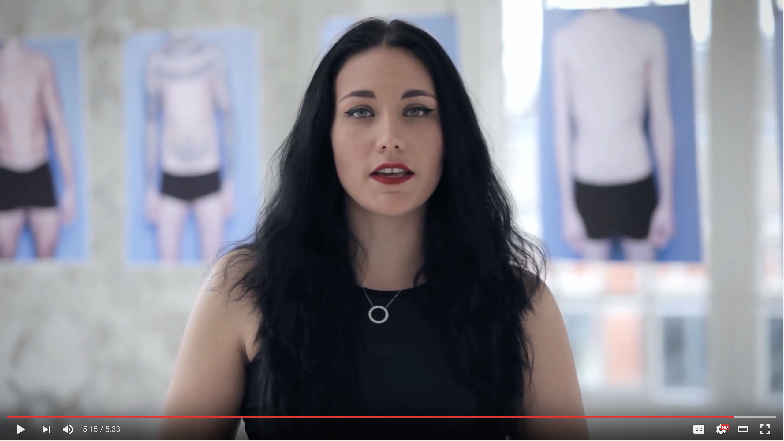
Body Positivity Video…
http://youtube.com/watch?v=qMLm6UKKxR8
Notes:
http://youtube.com/watch?v=qMLm6UKKxR8

