Slide 1
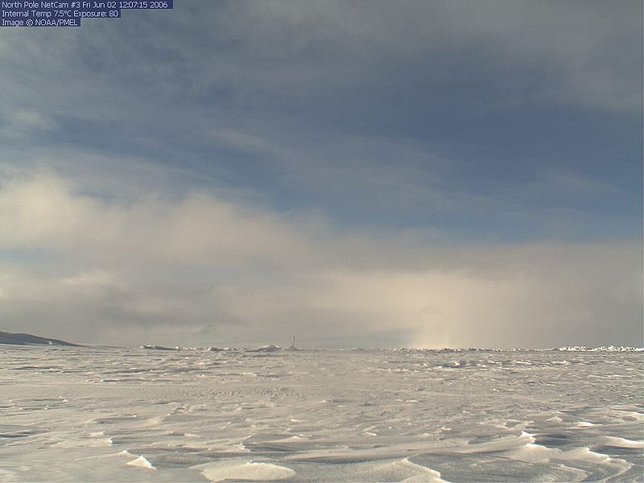

ICE STATION SURVIVAL

Slide 2

ICE STATION SURVIVAL
AIM
As a team, devise a strategy for survival in an
extreme environment
OBJECTIVES You will:
>Plan and explain to the group your immediate survival
plan to preserve life and prevent further injury
>Explain which tasks you will allocate to each surviving
member of the team with reasons why
>Formulate and outline a plan for a patrol to venture out
to seek assistance

Slide 3
ICE STATION SURVIVAL
Why is communication important?
What methods of communication are there?
What is effective communication?

Slide 4
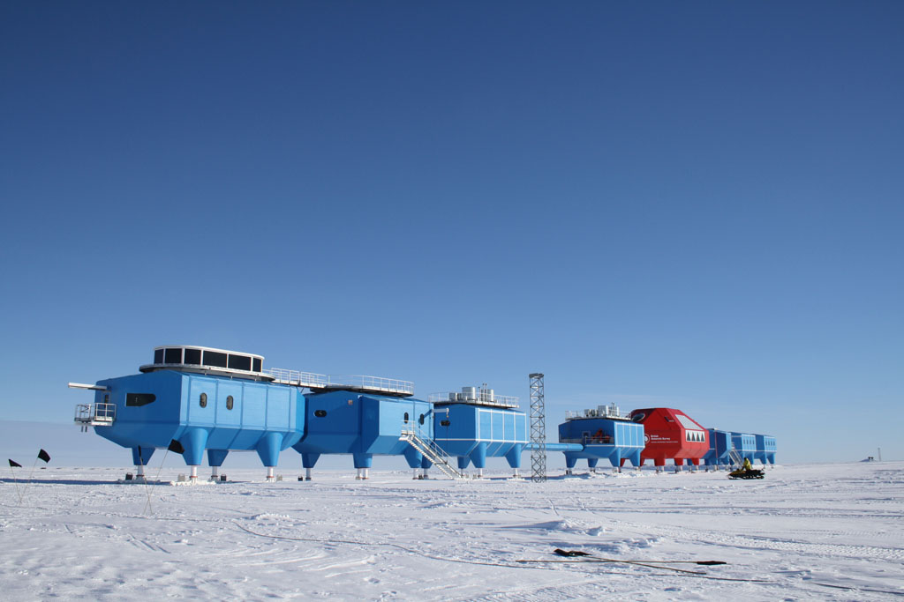
Medical Centre
Kitchen/Comms Centre
Accommodation
Fuel Pod
Specimen Lab
Main Generator

Slide 5
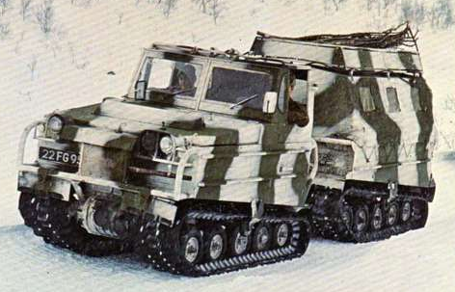
Oversnow vehicle

Slide 6
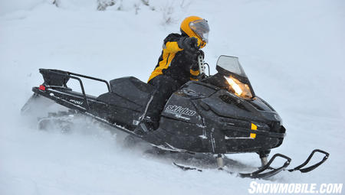
Skidoo
Can carry 2 personnel and small amount of stores
Only has enough fuel for approx 20 – 30 miles

Slide 7
ICE STATION SURVIVAL
The Survivors:
Medic
Survival Expert
Equipment specialist
Meteorologist
Navigation Officer
Electrical Engineer
Communications Officer
Driver
Chemist
Chef

Slide 8
ICE STATION SURVIVAL
Task 1
Discuss your situation, consider your options and decide on your immediate plan of action.
Be prepared to present your
strategy after 10 minutes of discussion within your group

Slide 9
ICE STATION SURVIVAL
Task 2
It has been 6 hours since the incident.
You have stabilised the environment, conducted a full situation assessment and have centralised your team in the safest area.
Your casualties will not survive beyond another 24 hours – you begin to think of escape options.
You should also consider the remainder of your team.
What are your next steps?
Be prepared to present your
strategy after 10 minutes of discussion within your group

Slide 10
ICE STATION SURVIVAL
Task 3
You have been unable to raise communications. You cannot fly the helicopter or salvage more fuel.
You decide to send a team out for assistance: who will go and why? What equipment will they take and why?
Be prepared to present your
strategy after 10 minutes of discussion within your group

Slide 11
ICE STATION SURVIVAL
Check Learning
1. Why is it important in this situation to ensure every individual
is allocated a task no matter how insignificant it may seem?
2. Extreme situations bring out the best in people; how do you think
some individuals may have adapted their skills in this scenario?
What methods of communication did you use?
Why is it important to tell people how we are feeling?

Slide 12
ICE STATION SURVIVAL
What would have happened if nobody had told the medic about the injured survivers?

Slide 13
ICE STATION SURVIVAL
In this scenario communication is key if you had just broken down and not discussed anything nothing would have been achieved. This would have made an already difficult situation impossible to cope with. Communicating with others in a task like this is the most important thing to do without it you would surely fail.

Slide 14
ICE STATION SURVIVAL
Communicating in life is crucial, what can start off as a small problem can easily turn into a dangerous one. The longer you leave a problem the worse it becomes and leads to it being increasingly difficult to talk about.

Slide 15
ICE STATION SURVIVAL
AIM
As a team, devise a strategy for survival in an
extreme environment
OBJECTIVES You will:
>Plan and explain to the group your immediate survival
plan to preserve life and prevent further injury
>Explain which tasks you will allocate to each surviving
member of the team with reasons why
>Formulate and outline a plan for a patrol to venture out
to seek assistance

